Slide 1
Create Your Retirement Income Plan
To help you move from saving to living
2

Slide 2
By creating a diversified income plan, you’ll feel more secure and prepared as you transition from saving for retirement to living in retirement.
2

Slide 3














Education on retirement challenges and how to overcome them
Navigate your retirement confidently with Fidelity
Insights for making more prudent and informed decisions
Support for creating a retirement income plan that balances growth potential and guaranteed income with tax-smart withdrawals
2

Slide 4
Where does a retirement income plan fit?
Your retirement income plan fits here
Saving for retirement
Approaching
Living in retirement
retirement
Age
20
30
40
50
60
70
80
90
100
Your savings plan fits here
Your estate plan fits here
2

Slide 5


CONSIDERING THE CHALLENGES
2

Slide 6





Five key challenges that your plan should address
Longevity Planning for a longer life
Health Care Costs
Rising and unpredictable
Inflation
Can erode your buying power
Market Volatility
Impact of a declining market
Withdrawals
Understand the importance of a sustainable spending rate
2

Slide 7


Preparing for a long retirement
LONGEVITY
65-year-old man
65-year-old woman
50% Chance
87 years
89 years
25% Chance
93 years
95 years
7
Source: Society of Actuaries RP-2014 Mortality Table projected with Mortality Improvement Scale MP-2021. For illustrative purposes only.

Slide 8
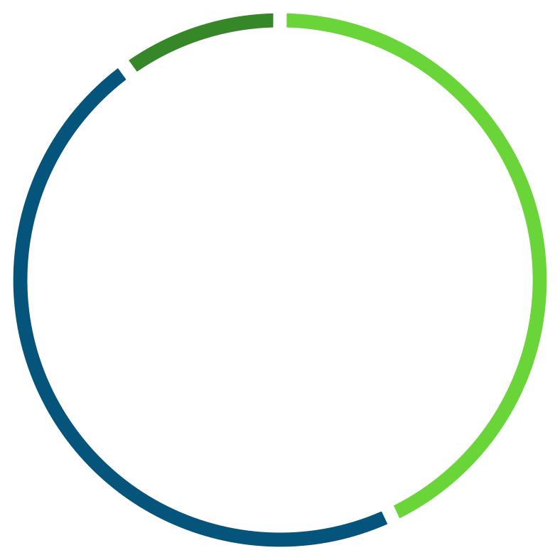
Health care costs: Rising and unpredictable
Health care is one of the largest retirement expenses
HEALTH CARE COSTS
An average 65-year-old should expect to spend approximately $165,000 in
health care and medical expenses during
retirement.² This estimate does not include possible long-term care.
10%
Out-of-pocket prescription drug expenses
47%
Medicare cost-sharing provisions, including copayments, coinsurance, and deductibles for doctors’ office visits
and hospital visits
43%
Medicare Part B
and Part D premiums¹
¹This estimate takes into account Medicare Part B base premiums and Medicare Part D (prescription drug coverage) premiums.
²“2024 Health Care Cost Estimate,” Fidelity Workplace Consulting, 2024.
For details used to estimate the $165,000 health cost, please refer to the Important Information section.
8

Slide 9






Optional slide
HEALTH CARE COSTS
Find coverage with Fidelity Medicare Services®
We provide complimentary support and guidance at every stage of your Medicare journey
Multiple plan options from trusted carriers vetted by Fidelity
Coverage that balances affordability, quality, and doctor preferences
A team that can help you enroll in coverage and provide ongoing assistance
Resources to learn about Medicare’s parts, when to enroll, and how to choose coverage that meets your needs
Fidelity.com/Medicare
9

Slide 10
Addressing the potential need for long-term care
Long-term care insurance helps protect your long-term savings
HEALTH CARE COSTS
70% of those aged 65 today will need long-term care support at some point in their lives¹
Ways to manage this risk:
Personal savings
Government assistance
Traditional long-term care insurance
Hybrid life insurance with long-term care
The average cost for a private nursing home room in the United States is approximately $117,000 per year²
1 in 5 people will need long-term care longer than 5 years¹
¹"How Much Care Will You Need?” LongTermCare.gov, U.S. Department of Health and Human Services, last modified on 2/28/2020, https://acl.gov/ltc/basic-needs/how-much-care-will-you-need.
²2023 Genworth Cost of Care Survey.
10

Slide 11
Inflation’s effect on your money
Inflation can affect buying power over time
INFLATION
Hypothetical Example: Increasing Costs
$60,000
$50,000
$50,000
$40,000
$30,000
$30,477
$23,880
$18,756
2% Inflation
3% Inflation
4% Inflation
$20,000
$10,000
$0
Today
5 years
10 years 15 years
Years from Retirement Start Date
20 years
25 years
11
All numbers were calculated based on hypothetical inflation rates of 2%, 3%, and 4% (historical average from 1926 to 2022 was 3%) to show the effects of inflation over time. Actual inflation rates may be more or less.

Slide 12
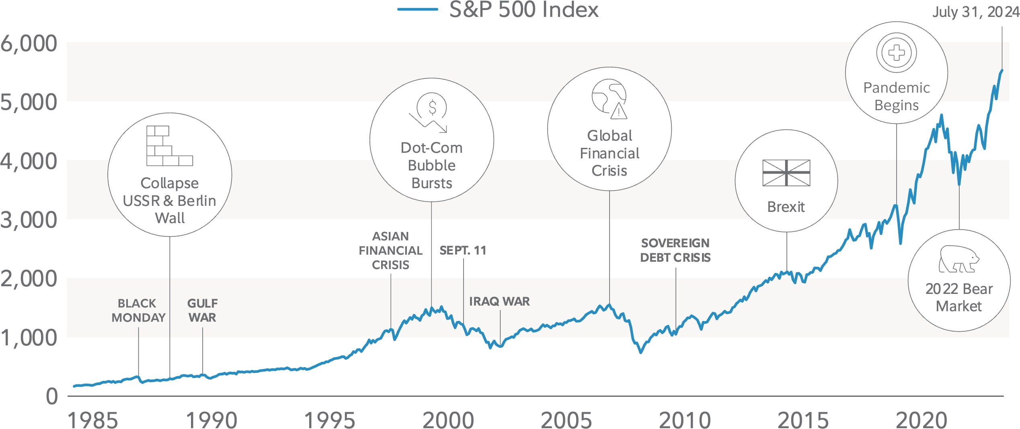
Keep perspective; downturns are normal
Despite market pullbacks, stocks have risen over the long term
MARKET VOLATILITY
Source: Fidelity Investments. Past performance is no guarantee of future results. The S&P 500® Index is a market capitalization– weighted index of 500 common stocks chosen for market size, liquidity, and industry group representation. S&P and S&P 500 are registered service marks of Standard & Poor’s Financial Services LLC.
12

Slide 13
Impact of withdrawals in retirement
Withdrawing too much, too soon can be costly
WITHDRAWALS
Withdrawal rate (adj. for inflation)*
4%
5%
$2,000,000
Value of portfolio
$1,500,000
$1,000,000
$500,000
$0
65
70
75
80
85
90
95
100
Age
*Hypothetical value of assets held in a tax-deferred account after adjusting for monthly withdrawals and performance. Initial investment of $500,000 invested in a portfolio of 50% stocks, 40% bonds, and 10% short-term investments. Hypothetical illustration uses historical monthly performance from Ibbotson Associates for the 35-year period beginning January 1972. Stocks, bonds, and short-term investments are represented by the S&P 500® Index, U.S. intermediate-term government bond, and U.S. 30-day T-bills, respectively.
Initial withdrawal amount based on 1/12th of applicable withdrawal rate multiplied by $500,000. Subsequent withdrawal amounts based on prior month’s amount adjusted by the actual monthly change in the Consumer Price Index for that month. This chart is for illustrative purposes only and is not indicative of any investment. Past performance is no guarantee of future results.
13

Slide 14


Combined impact of returns and withdrawals
Sequence of returns may have no impact when accumulating assets
WITHDRAWALS
The returns you experience: Both investors start and end with the same investment amounts
SUSAN
ROBERT
Portfolio returns are positive during early years, negative returns later
Portfolio returns are negative during early years, positive returns later
Accumulation
Susan Robert
Assets
40
45
50
55
60
65
Age
This hypothetical example is for illustrative purposes only. It is not intended to predict or project investment results. Your rate of return may be higher or lower than that shown above.

Slide 15

Combined impact of returns and withdrawals
But sequence of returns may have enormous impact in retirement
WITHDRAWALS
Impact of sequence of returns on portfolio value (when taking withdrawals to fund retirement)
THE IMPACT ON YOUR PORTFOLIO
Distribution
Positive returns early on help the portfolio grow throughout retirement, even with ongoing withdrawals
Assets
Negative returns in the early years, on top of taking withdrawals, can drain a retirement portfolio
Susan Robert
65
70
75
80
85
90
Age
This hypothetical example is for illustrative purposes only. It is not intended to predict or project investment results. Your rate of return may be higher or lower than that shown above.

Slide 16


Creating your retirement income plan

Slide 17



Identify your income sources and expenses
Income sources
Predictable income
sources (Social Security, pension, and annuities)
Part-time work
Rental property
Withdrawal sources
Retirement accounts (traditional/Roth 401(k), 403(b), IRA, etc.)
Savings accounts
Brokerage accounts
Equity compensation
Expenses
Essential expenses
Discretionary expenses

Slide 18




Your retirement
income plan
Sources
Expenses
Predictable income
(income sources)
Social Security, pensions, fixed income annuities
Essential expenses
Food, housing, health care, taxes, your other must-haves
Align income sources with expenses
Your savings and investment income
(withdrawal sources)
Traditional and Roth IRA, brokerage account, savings account
Discretionary expenses
Retirement nice-to-haves

Slide 19
The building blocks of a successful diversified retirement income plan
Guarantees
help your retirement
plan succeed
What guaranteed sources
of income are you expecting in retirement (e.g., pensions, annuities)?
Growth Potential
to meet your long-term needs
Flexibility
to refine your plan over time
How are you investing for growth potential
(e.g., stocks)?
There is a balance between flexibility and efficiency. Which is more important to you?

Slide 20
Three types of predictable income:
Guarantees
Social Security
Pensions
Income annuities

Slide 21









Social Security
Improve your payout by waiting to claim benefits
GUARANTEES
Full retirement age
Permanently reduced benefit amount
Maximum benefit amount
% of benefit earned
124%
100%
108%
87%
70%
62
63
64
65
66
Claim age
67
68
69
70
21
Always consult an attorney who can help you by drafting the appropriate legal documents to suit your particular needs.

Slide 22

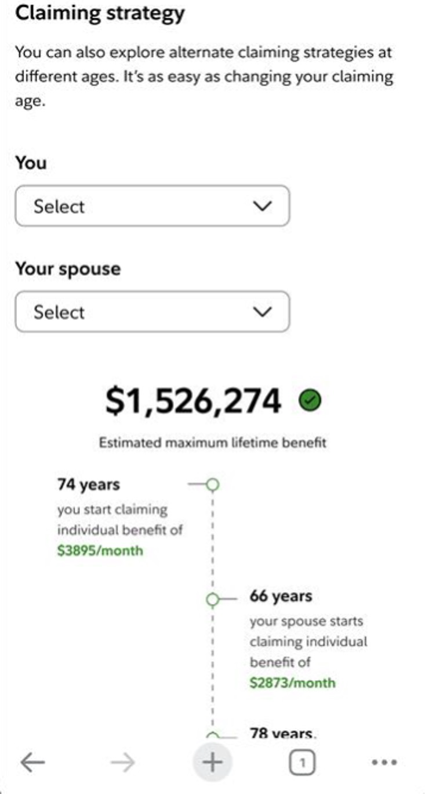



Optional slide
GUARANTEES
Optimizing your claiming strategy
Using our Social Security Benefit Calculator
Determine a Social Security claiming strategy that works best for your retirement plan
Compare estimated monthly and lifetime benefits across different claiming ages
Review individual, spousal, and survivor benefits in various scenarios
See how waiting to claim may help you maximize your monthly benefit
22
Screenshot is for illustrative purposes only.

Slide 23



Pensions
GUARANTEES
The options you choose for your payouts make a difference
When you start receiving pension payouts influences your payout amount
Once you start payments, you’re locked in
23

Slide 24
Guaranteed income annuities
Consider these two common annuity types to help pay for essential expenses
GUARANTEES
Deferred fixed income annuity¹
Receive income payments in one year or more from the initial investment
The longer the deferral period, the higher the income payment amounts
Immediate fixed income annuity²
Receive income payments within 12 months of investment
Payments are higher when purchasing a future income stream vs. receiving income within 12 months of investment through a single-premium income annuity (SPIA)
¹Deferred income annuity contracts are irrevocable, have no cash surrender value, and no withdrawals are permitted prior to the income start date.
²In order to provide an income stream, there is no or limited access to assets.
Annuity guarantees are subject to the claims-paying ability of the issuing insurance company.

Slide 25
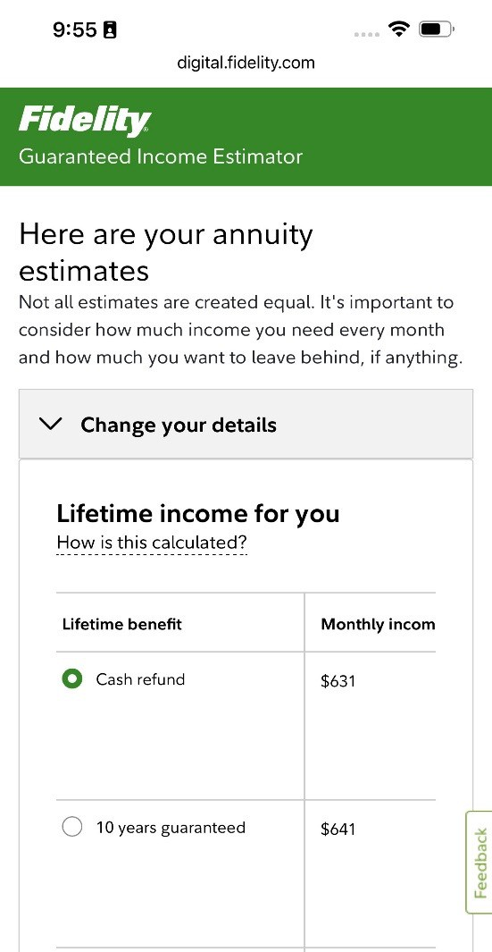
Optional slide
GUARANTEES
Estimate the impact of a fixed income annuity
Using our Guaranteed Income Estimator
Understand the income an annuity could provide
Estimate payments based on amount invested
Estimate investment needed based on payments desired
Review potential payout options
Screenshot is for illustrative purposes only.
Annuity guarantees are subject to the claims-paying ability of the issuing insurance company.

Slide 26
Use investment income to fund discretionary spending
Growth Potential
Reassess your appetite for risk and adjust asset allocations
Meet your long-term needs and keep up with inflation
26

Slide 27





Manage your portfolio
Build an investment strategy and remain disciplined
GROWTH POTENTIAL
100%
14%
6%
20%
21%
15%
28%
10%
5%
5%
15%
30%
35%
35%
42%
25%
30%
9%
40%
49%
25%
60%
50%
45%
12%
15%
21%
70%
50%
18%
Short-Term
Conservative
Moderate with Income
Moderate
Balanced
Growth with Income
Growth
Aggressive Growth
Most Aggressive
Low risk
High risk
Short-Term
Bonds
Domestic Stocks
Foreign Stocks
The purpose of the target asset mixes is to show how target asset mixes may be created with different risk and return characteristics to help meet an investor’s goal. You should choose your own investments based on your particular objectives and situation. Remember, you may change how your account is invested. Be sure to review your decisions periodically to make sure they are still consistent with your goals. The asset allocation does not ensure a profit or guarantee against a loss.
Past performance is no guarantee of future results.
27

Slide 28
Your plan should align your income sources with your overall retirement vision
Flexibility
Create a plan that can adapt to life’s inevitable curveballs
Review and adjust your plan as your priorities change
28

Slide 29






Prepare for the unexpected
Build flexibility into your plan
FLEXIBILITY
 | Lifetime Income _{Social Security, pensions} Annuities with guaranteed lifetime income |  | Investment Income Principal, interest, dividends | Combined Income
Market Volatility
Longevity
Inflation
Flexibility
Strong Alignment
Moderate Alignment
Note: The terms “moderate” and “strong” above are intended to represent which product categories generally align with a desired objective. The check marks do not, however, precisely represent the features and benefits of specific products. Certain features and benefits are subject to product terms, exclusions, and limitations.
Annuity guarantees are subject to the claims-paying ability of the issuing insurance company.
29

Slide 30
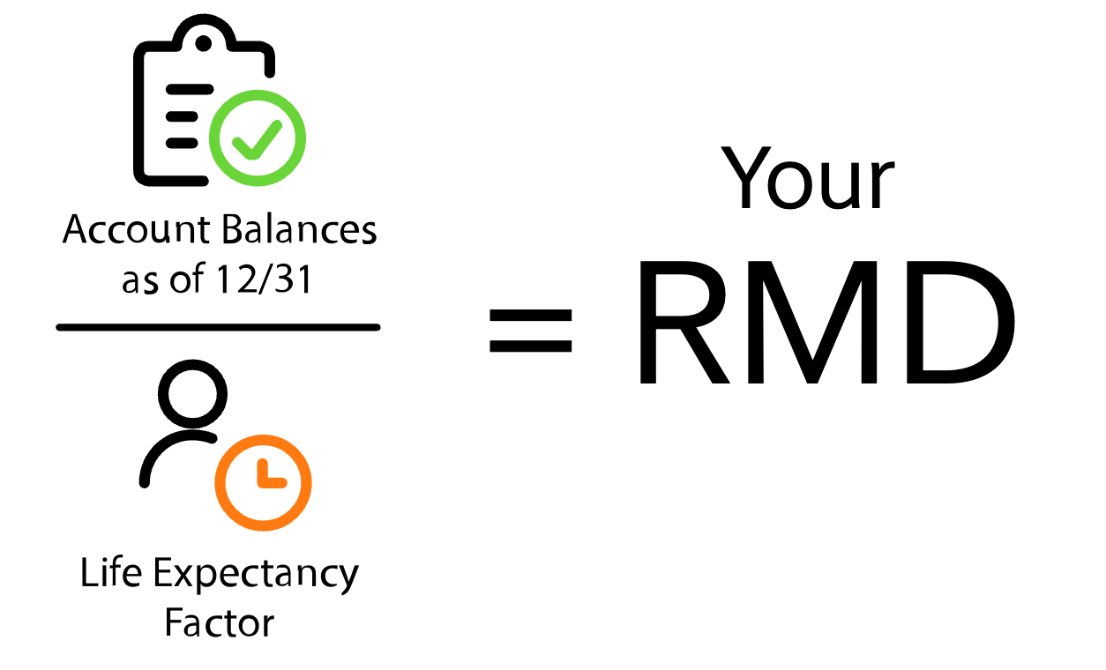
Understanding Required Minimum Distributions (RMDs)
Be ready to take action at age 73
RMD
Once you reach age 73, you must take a yearly RMD from tax-deferred retirement accounts
Distributions can be:
Used as income
Invested for growth
Donated to a qualified charity
Used to purchase a qualified annuity
RMDs are taxed as ordinary income unless you make a qualified charitable contribution (QCD)
You can reduce your IRA balance—and therefore your RMDs— through a Roth conversion
The deadline for taking your RMD is December 31 each year
A Roth conversion is a taxable event, and will increase your taxable ordinary income in the year you convert.
30

Slide 31

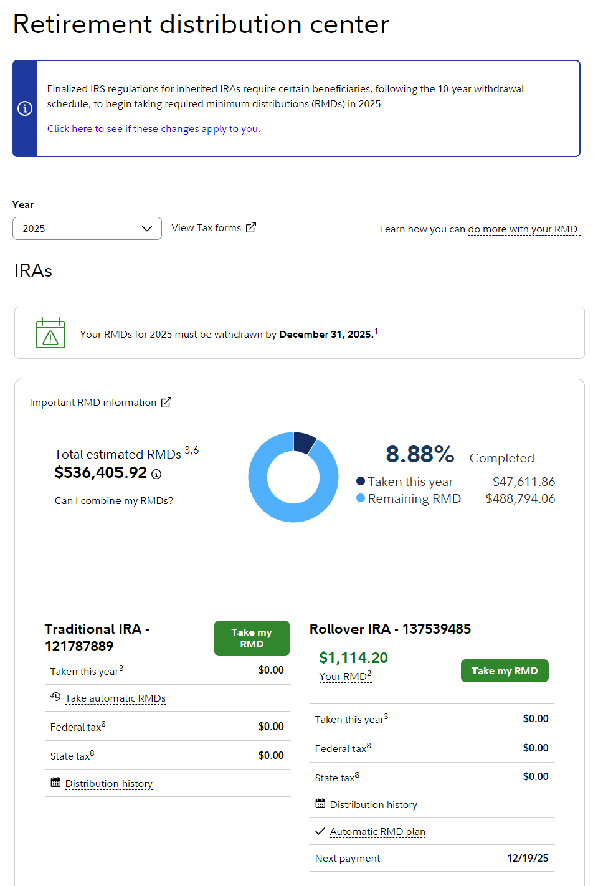



Optional slide
RMD
Manage your Fidelity RMDs
Using our Retirement Distribution Center
Get insights on and help with satisfying your annual RMDs
Access historical withdrawal amounts
View suggested withdrawal amount, updated annually at the portfolio and account level
Track withdrawals and withheld taxes to satisfy your RMD in time for each year’s deadline
31
Screenshot is for illustrative purposes only.

Slide 32








Managing your tax situation
Estimate your tax bracket
Adjust your taxable and nontaxable investment mix
Consult a Fidelity professional
It’s important that you understand how benefits and income are taxed
32

Slide 33














Optional slide
Estimate your taxes in retirement
Using our Retirement Strategies Tax Estimator
Understand your potential tax impact
Estimate your taxes for this year or last year
Plan charitable giving amounts
Target withdrawals by account type
33
Screenshot is for illustrative purposes only.

Slide 34



How Fidelity can help
Meet with a
Fidelity professional
Create a retirement income plan
Implement your plan with the right mix of investments
Balance growth potential and guaranteed income with tax-smart withdrawals
35

Slide 35
Tools to assist you
in the planning process
Insights from Fidelity Wealth ManagementSM
Receive timely news, events and wealth strategies from top Fidelity thought leaders
Fidelity.com/Insights
Planning & Guidance Center
Find out how prepared you are for retirement, how much retirement income you may have, and how long your money may last
Retirement Income Calculator
Get a quick estimate
and explore what factors affect your cash flow
in retirement
Guaranteed Income Estimator
Use this tool to estimate the income you could receive from a fixed income annuity
35

Slide 36

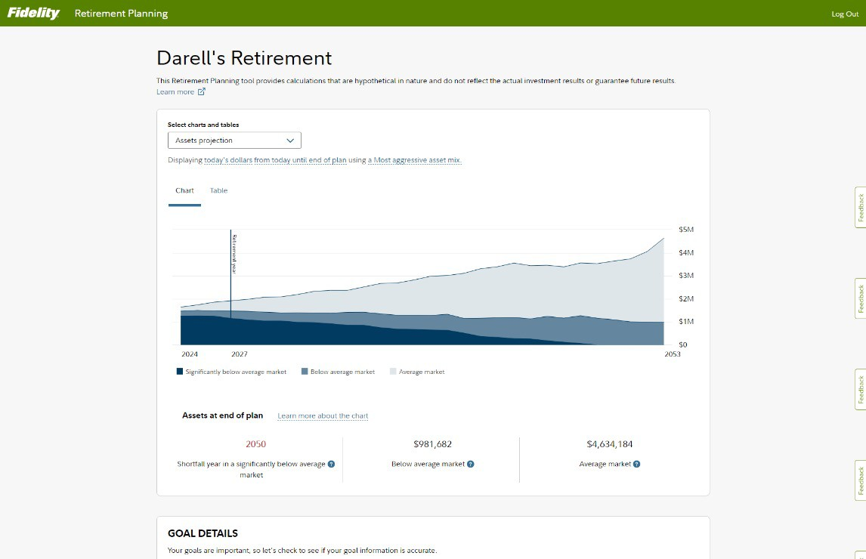

Optional slide
Visit our Planning & Guidance Center
Fidelity.com/calculators- tools/retirement-planning- and-guidance
Screenshot is for illustrative purposes only.
IMPORTANT: The projections or other information generated by the Planning & Guidance Center’s Retirement Analysis regarding the likelihood of various investment outcomes are hypothetical in nature, do not reflect actual investment results, and are not guarantees of future results. Your results may vary with each use and over time.
36

Slide 37
By creating a diversified income plan with the right mix of investments, you’ll feel more secure and prepared as you transition from saving for retirement to living in retirement.

Slide 38
Important Information
This information is intended to be educational and is not tailored to the investment needs of any specific investor.
Keep in mind that investing involves risk. The value of your investment will fluctuate over time, and you may gain or lose money. Details for the estimated $165,000 health care cost referenced on page <XX>.
This estimate is based on a single person retiring in 2024, 65 years old, with life expectancies that align with Society of Actuaries’ RP-2014 Healthy Annuitant rates projected with Mortality Improvement Scale MP-2021 as of 2022. Actual assets needed may be more or less depending on actual health status, area of residence, and longevity. Estimate is net of taxes. The Fidelity Retiree Health Care Cost Estimate assumes individuals do not have employer-provided retiree health care coverage, but do qualify for the federal government’s insurance program, Original Medicare. This calculation takes into account Medicare Part B base premiums and cost-sharing provisions (such as deductibles and coinsurance) associated with Medicare Part A and Part B (inpatient and outpatient medical insurance). It also considers Medicare Part D (prescription drug coverage) premiums and out-of-pocket costs, as well as certain services excluded by Original Medicare. This estimate does not include other health-related expenses, such as over-the-counter medications, most dental services, and
long-term care.
Fidelity does not provide legal or tax advice. The information herein is general in nature and should not be considered legal or tax advice. Consult an attorney or tax professional regarding your specific situation.
Fidelity Insurance Agency, Inc., and, in the case of variable annuities, Fidelity Brokerage Services, Member NYSE, SIPC, distribute insurance and annuity products that are issued by third-party insurance companies, which are not affiliated with any Fidelity Investments company, as well as insurance and annuity products issued by Fidelity Investments Life Insurance Company (“FILI”), 900 Salem Street, Smithfield, RI 02917 and, in New York, by Empire Fidelity Investments Life Insurance Company® (“EFILI”), New York, NY. FILI is licensed in all states except New York; EFILI is licensed only in New York. A contract’s financial guarantees are subject to the claims-paying ability of the issuing insurance company.
Fidelity Brokerage Services LLC, Member NYSE, SIPC, 900 Salem Street, Smithfield, RI 02917
© 2025 FMR LLC. All rights reserved. 736336.23.0

