Slide 1

Insurance counseling
Randy Rodgers
Manager of Insurance Counseling

Slide 2


JABA’s mission is to promote, establish and preserve sustainable communities for healthy aging that benefit individuals and families of all ages.

Slide 3

Federal

Slide 4

State

Slide 5

Local
Insurance Counseling Program

Slide 6
Medicare Counseling
Free
Unbiased
Medicare Counselors:
Volunteer
Highly Training
Certified
Get the Facts.
Not the Sales Pitch.

Slide 7
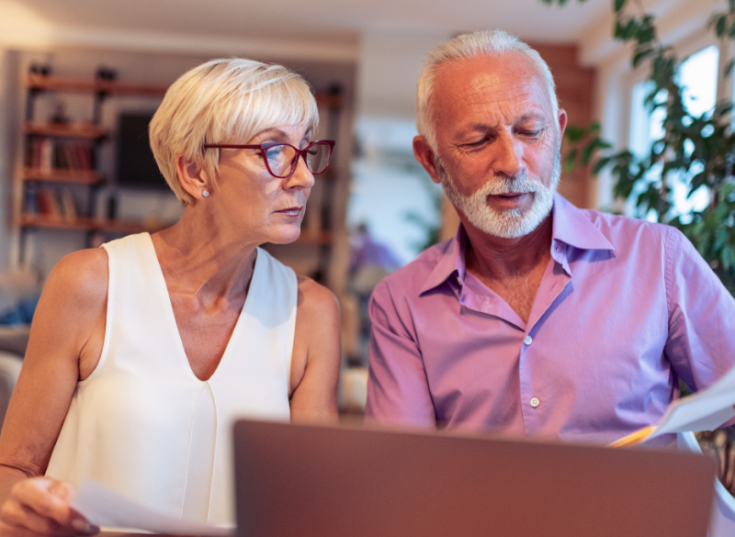
Help people who are setting up their Medicare
Help people with questions about Medicare
Help people evaluate their options during Open Enrollment

Slide 8
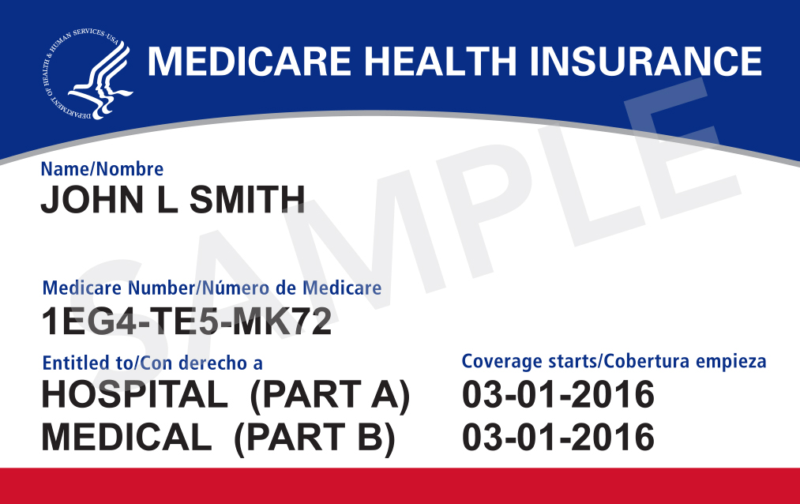
Medicare

Slide 9
Two paths to Medicare
Original
Medicare
Medicare
Advantage
or

Slide 10
Original
Medicare
Medicare
Advantage
or
Part A
Part B
Managed Health Care Insurance
Medigap
Part D

Slide 11
Part A
Part B
Medigap
Part D

Slide 12
Part A
Part B
80%
Medigap
20%
Part D

Slide 13
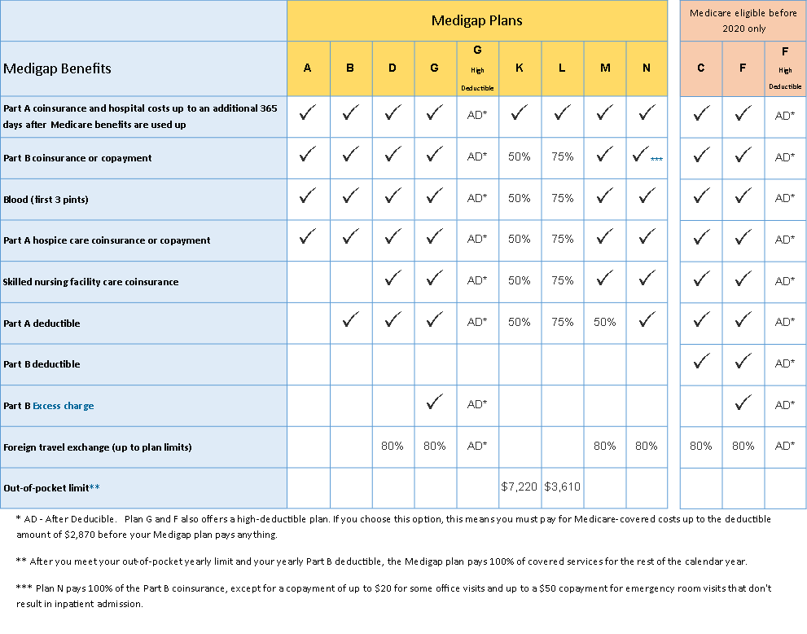

Slide 14
Medicare
Advantage
Private Insurance Company
Still have Medicare Parts A & B
Provider Networks
Copays and Coinsurance
Out of Pocket Maximum
Extras: Dental, Vision, Hearing Aids

Slide 15
Original
Medicare
Medicare
Advantage
or
Premiums are
More expensive
More certainty
of coverage
Premiums are
Less expensive
Extras
Less certainty
of coverage

Slide 16
Original
Medicare
Medicare
Advantage
or
Premiums are
More expensive
More certainty
of coverage
Premiums are
Less expensive
Extras
Less certainty
of coverage

Slide 17
Advantage 65
Is Not
Medicare Advantage Plan

Slide 18
Original
Medicare
Part A
Part B
Medigap
Advantage 65
Part D

Slide 19
Advantage 65
Supplement
Vision
Dental
Prescription

Slide 20
Advantage 65
Supplement
Vision
Dental
Medicare Part D
Prescription

Slide 21
Part D
Prescription Drug Insurance

Slide 22
$2,100 Cap
Part D
Prescription Drug Insurance

Slide 23
Open Enrollment
Oct 15 – Dec 7
Part A
Part B
Managed Advantage
Medigap
Part D

Slide 24
Open Enrollment
Oct 15 – Dec 7
Part A
Part B
Managed Advantage
Medigap
Part D

Slide 26
Helped 2,937 People
Open Enrollment
Oct 15 – Dec 7

Slide 27
Helped 2,937 People
Open Enrollment
Oct 15 – Dec 7
Saved $4,051,075

Slide 28
Medigap Birthday Rule
New Virginia law – July 1, 2025
If you already have a MediGap
Shop for a better deal
Guaranteed Issue Right
No medical underwriting
Your birthday and 60 days
Stay on same letter plan

Slide 29
IRMAA
2025 PART B PREMIUMS BY INCOME (YEARLY INCOME FROM 2023 TAX RETURN)
File individual tax return | File joint tax return
$106,000 or Less | $212,000 or Less | $185
above $106,000 up to $133,000 | above $212,000 up to $266,000 | $259
above $133,000 up to $167,000 | above $266,000 up to $334,000 | $370
above $167,000 up to $200,000 | above $334,000 up to $400,000 | $480.90
above $200,000 up to $500,000 | above $400,000 up to $750,000 | $591.90
$500,000 or Above | $750,000 or Above | $628.90

Slide 30
IRMAA
2025 PART B PREMIUMS BY INCOME (YEARLY INCOME FROM 2023 TAX RETURN)
Beneficiaries who are married and lived with their spouses at any time during the year, but who file separate tax returns from their spouses with modified adjusted gross income:
$106,000 or Less | $185
above $106,000 up to $394,000 | $591.90
$394,000 or Above | $628.90

Slide 31
IRMAA
2025 PART D PREMIUMS BY INCOME (YEARLY INCOME FROM 2023 TAX RETURN)
File individual tax return | File joint tax return
$106,000 or Less | $212,000 or Less | Your Part D Premium
above $106,000 up to $133,000 | above $212,000 up to $266,000 | Premium + $13.70
above $133,000 up to $167,000 | above $266,000 up to $334,000 | Premium + $35.30
above $167,000 up to $200,000 | above $334,000 up to $400,000 | Premium + $57.00
above $200,000 up to $500,000 | above $400,000 up to $750,000 | Premium + $78.60
$500,000 or Above | $750,000 or Above | Premium + $85.80

Slide 32
Medicare Extra Help (Prescriptions)
Single Person | If gross monthly income is below $1,883 and assets below $17,220
Married Couple | If gross monthly income is below $2,555 and assets below $34,360
Pays for Part-D Premium on select Part D plans, Deductible is removed, copays are $4.90 generic, $12.15 brand name, you can change Part-D plan during the year.

Slide 34

Medicare Scams or Fraud
Fraud can happen to anyone of us, but the more we know, the better we can be at stopping it.
Specific scams to watch out for:
False Billing
"Free" Medical Equipment
Genetic Testing Scams
Medicare Card Scams
Misleading Marketing
SMP Toll Free Hotline
1-800-938-8885
Notes:
Aging Services Coordinators provide unbiased service coordination and supports for adults 60+, caregivers, and adults with disabilities in making plans to reach their short-term and long-term goals.
Aging Services Coordinators help individuals navigate resources inside and outside of JABA and advocates for their needs.
JABA’s Senior Helpline is the first point of contact for many individuals to get quick-answers to aging questions or get connected to an Aging Services Coordinator.
Coordinators provide information and application assistance within JABA like Home Delivered Meals, Companion Support Services, Emergency Financial Services, Wills for Seniors, and Heating/Cooling Assistance.
They also provide assistance coordinating outside resources like housing and transportation applications, health resources (including mental health), home modification support, and financial assistance.

Slide 35
Medicare Scams or Fraud
Fraud can happen to anyone of us, but the more we know, the better we can be at stopping it.
Things you should do:
Guard your Medicare number
Review your Medicare Summary Notices
Be cautious of free offers
Don't share personal information over the phone
Report suspicious activity
SMP Toll Free Hotline
1-800-938-8885

Slide 36

JABA’s values
Get the Facts. Not the Sales Pitch.

Slide 37
Insurance counseling
434-817-5248
JABAIC@jabacares.org

