Slide 1
University of Virginia
Open Enrollment Town Hall
Hoos Well Well-being Team – Vic Tringali
UVA Faculty and Employee Assistance Program (FEAP) – Monica Maughlin
Fidelity – Nathan Dixon
Benefits Team – Erica Wheat
TIAA – Rich Carroll

Slide 2





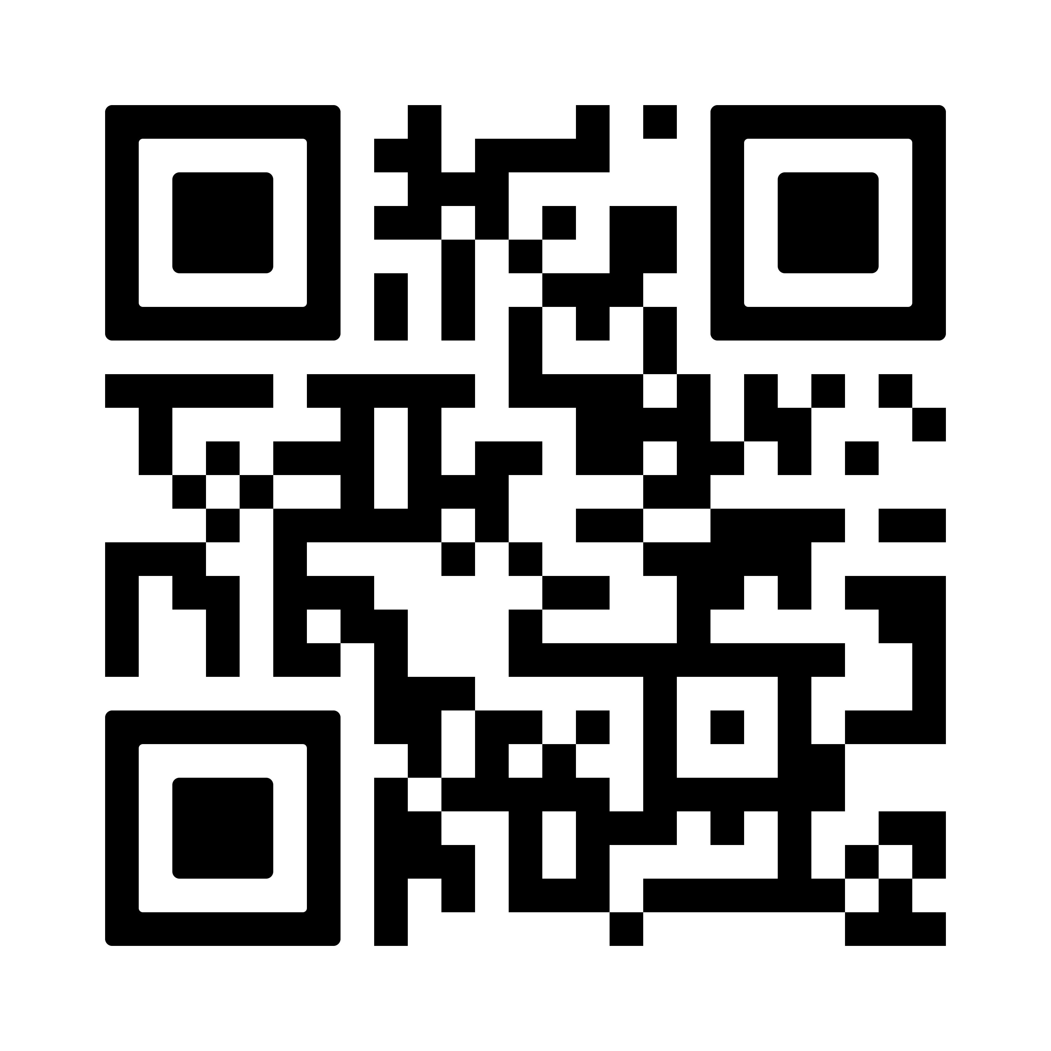
EARN UP TO $500!
Healthy Activity | Reward
Create an Account (new users only) | $10
Receive and report your annual well check | $100
Complete a Personal Health Assessment | $100
Earn rewards through additional healthy activities | Up to $300
IMPORTANT DATES:
November 30, 2025: Deadline to earn and record activities
February 2026: Start earning rewards
To qualify, you must be enrolled in an eligible plan and actively employed at the time of payout. Grant-funded postdoctoral fellows, retirees, & COBRA enrollees in the UVA Health Plan are not eligible for monetary rewards.
*Cash rewards are deposited in the subscriber’s paycheck quarterly and are subject to taxation.

Slide 3


Here for You
An Introduction to Your Faculty & Employee Assistance Program

Slide 4


FEAP has been operating for more than 30 years and is committed to employee well-being!
FEAP provides resources and short-term counseling services for you and your adult (age 18+) family members, at no cost.
Supervisors, managers, and University leaders can use FEAP for consultation on how to best serve, support, and manage their employees through everyday concerns and challenging times.

Slide 5

FEAP Services
are confidential

Slide 6

Some Reasons You Might Make
A FEAP Appointment
Stress and Life Management
Stress Management
Work/Life Design
Life Transitions
Mental Health & Emotional Well-being
Emotional Well-being Coaching
Depression & Anxiety
Grief and Loss
Trauma
Substance misuse
Relationship & Interpersonal Concerns
Relationships, including Couples
Parenting, Blended & Extended Families Concerns
Workplace Relationships
Separation & Divorce

Slide 7



Crisis Care
FEAP's Crisis & Care Coordinator
Sees faculty and staff in crisis to assess, stabilize and ensure connection to needed resources
Consultation with leaders on emotional, behavioral and safety concerns & needs for critical incident response.
Same day appointments available Monday through Friday

Slide 8

Critical Incident Response
Crisis Aid individually or in supportive groups sessions
Leadership Coaching, Consultation & Support

Slide 9




Eldercare, Financial,
Fraud & Legal Services
Upon referral from FEAP:
Free 60-minute consultation
Fraud resolution services
Wide variety of financial topics
Eldercare related concerns
Free 30-minute consultation
Full range of legal issues
Employment law exclusion
Discount of 25% on services billed hourly

Slide 10


Group Offerings:
Kultivate Konnection
A Monthly Emotional Wellness Break
A welcoming space to connect, share experiences and explore strategies for life’s challenges in a supportive community
Share and receive culturally responsive support and meaningful connection
Meets virtually on the second Thursday of each month for one hour

Slide 11


Group Offerings:
Reset Space
A Monthly Nervous System Reset
A monthly interactive opportunity to learn and practice evidence-based strategies for managing stress.
Explore how stress impacts the brain and body and why it matters.
You will learn techniques to support the shift from tension to ease.
Offered virtually on Tuesdays each month.

Slide 12



FEAP for You
Readily Available & Self-Guided Support
Toolkits to Support your Well-Being
Recorded webinars on topics related to emotional health and well-being
Virtual Resource Library
Tune As You Go library
21 Ways in 21 Days Program
Tip of the Month
FEAP Substack
You're Worth Checking On!
FEAP Resource Navigator
One-minute survey to personalize resource selection

Slide 13

Meet the Team
Mission
To be the primary support resource for University of Virginia faculty and staff and the employees of our community partnerships seeking services for mental health and well-being in personal, professional, and organizational matters.

Slide 14
Connecting with FEAP
Appointments:
Make an appointment on the FEAP website or by phone at 434-243-2643
Urgent Support:
Call 434-995-8305 to reach Rodney Diehl, Crisis & Care Coordinator
After Hours Call : 434-243-2643
Visit one of our locations:
1932 Arlington Blvd., Suite 6
UVA West Complex

Slide 15
:
Schedule an Appointment
434.243.2643
uvafeap.com
Thank You

Slide 16


Nathan Dixon and Joel Wise, Fidelity Workplace Financial Consultants for the University of Virginia
Licensed professionals,
experienced in helping
people plan for their financial futures.
Can help you plan for both
expected and unexpected life events.
Services are completely
complimentary through UVA retirement.
We encourage you to include
your spouse, family member,
or loved one in the conversation.
Consultations available by phone, Zoom or in person.
Learn more at
NetBenefits.com/UVA or
schedule an appointment at
Fidelity.com/Schedule,
1-800-642-7131, or by
scanning QR code.
Investing involves risk, including risk of loss.
Fidelity Brokerage Services LLC, Member NYSE, SIPC, 900 Salem Street, Smithfield, RI 02917
© 2024 FMR LLC. All rights reserved. 861220.8.124

Slide 17






Introducing Fidelity Medicare Services®
Fidelity.com/TalkMedicare
Impartial guidance
from Fidelity’s licensed insurance agents who specialize in Medicare
Comprehensive coverage
from vetted, high-quality insurance companies
Digital tools
and resources to get educated or self-serve
Including:
Complimentary guidance
Help making personalized choices
Year-over-year support once enrolled
Including:
Medicare Advantage
Medicare Supplement (Medigap)
Part D prescription plans
Stand-alone vision and dental plans
Travel health insurance
Including:
Online shopping and enrollment
Webinars and learning guides to answer common questions
And much more…
Consultative conversations
about your situation
Help selecting a plan that addresses your unique needs
Tools available at
Fidelity.com/TalkMedicare
Notes:
Whether you’re becoming newly eligible, or you’ve been enrolled in Medicare for a number of years, Fidelity Medicare Services can provide you with complimentary assistance and support to help find and enroll into coverage that meets your needs. You don’t have to have a relationship with Fidelity to use this service, so your Medicare-eligible loved ones can get the support and help they need too!
Here’s how it works….
Once you’re within 12 months of needing to make a Medicare-related decision, you have access to a team of Fidelity licensed insurance agents specializing in Medicare who provide Medicare education and impartial guidance on coverage choices. When the time is right, they can help you enroll into the Medicare plan of your choosing, making it a simple and complete experience from start to finish. The agents are not incentivized by commissions for selling Medicare plans, so you can rest assured their focus is on guiding you based on your individual needs and preferences, ensuring you’re confident in your healthcare coverage decisions.
Fidelity Medicare Services evaluates various health insurance companies offering Medicare plans, and based on their standards for quality and customer service, they contract with them to offer their products through the service. By using vetted insurers, they can provide you with a manageable short-list of Medicare plan options including:
Medicare Advantage plans
Medicare Supplement (or Medigap) plans
Part D prescription drug plans
Stand-alone dental and vision plans, as well as...
Travel health insurance
If you’re not yet within a year of making your Medicare related decisions, or if you prefer to explore resources on your own, the Fidelity Medicare Services website houses extensive digital resources and learning guides you can explore at your own pace. You can also shop and compare plan options, view on-demand Medicare webinars, as well as enroll into coverage online if you prefer.

Slide 18



Personalized help with your Medicare decisions
Guidance and support at every stage of your journey
Ready to make Medicare decisions
New to Medicare
Already on Medicare
Planning ahead
At least 64 years old (or younger, if enrolling early due to certain medical conditions or disabilities)
65 or older and retiring within 12 months
Compare options during the Medicare Annual Enrollment Period (October 15 – December 7)
Change plans outside of the Annual Enrollment Period due to special circumstances (for example, moving to a new Medicare service area)
More than a year away from Medicare eligibility
Under 64 years old, interested in learning about Medicare for planning purposes
Explore educational resources and guidance tools on our website
Notes:
Fidelity Medicare Services is best suited for anyone enrolling into Medicare for the first time, as well as those who are already on Medicare and want to consider their options.
Specifically, this includes individuals who are:
Age 64+ (approaching Medicare-eligibility)
Younger than 64 and eligible for Medicare due to certain medical conditions or disability
Age 65 and older and transitioning to Medicare for the first time as they retire
Or those already on Medicare and wanting to review their options
Since coverage and personal needs may change every year, it’s important to review your coverage annually to ensure it’s still meeting your needs. Fidelity Medicare Services can help you review and compare plans available during Medicare’s Annual Enrollment Period and help you make a switch if needed. The Annual Enrollment Period is each year from October 15th through December 7th.
If you’re still a few years away from your Medicare eligibility, or if you’re someone who’s just interested in planning ahead, you can take advantage of the many online resources.

Slide 19
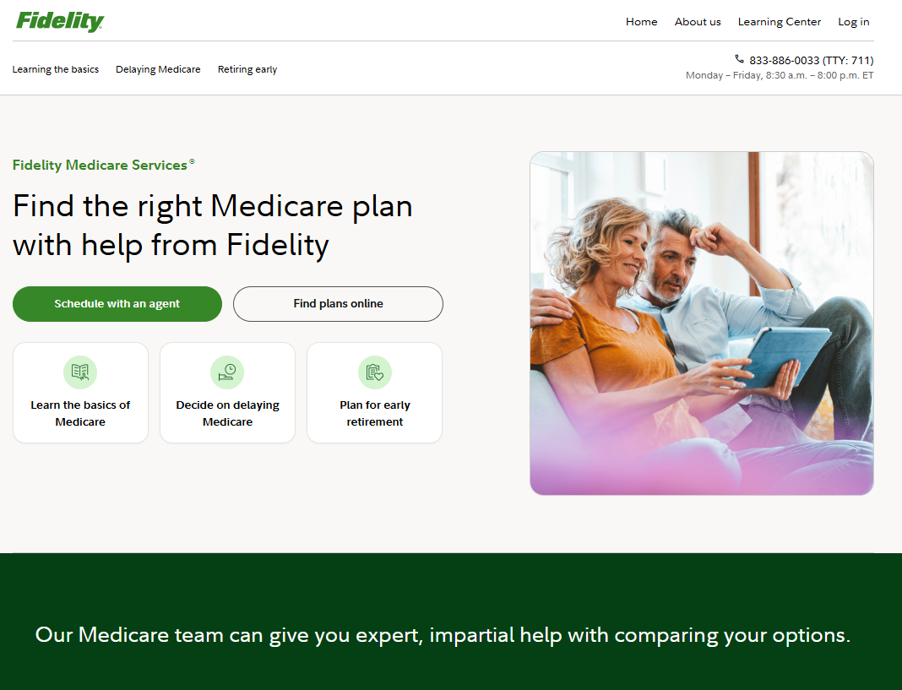






How to engage with Fidelity Medicare Services
View educational resources and pre-recorded webinars in our Learning Center
Attend a live webinar about Medicare
Call our team directly: 833-886-0033 Monday – Friday, 8:30 a.m. – 8:00 p.m. ET
Schedule an appointment with a licensed insurance agent at Fidelity: Fidelity.com/TalkMedicare
Shop plans and enroll independently through our website
This document is owned by Fidelity Medicare Services®. We do not offer every plan available in your area. Please contact
www.medicare.gov or 1-800-MEDICARE (TTY users should call 1-877-486-2048), 24 hours a day/7 days a week or your
local State Health Insurance Program (SHIP) to get information on all of your options. Fidelity Medicare Services is operated
by Fidelity Health Insurance Services, LLC (“FHIS”), and FMR LLC (“FMR”) is the parent company of FHIS. Unless otherwise
indicated, the information and items published in this document are provided by FHIS for informational purposes only and are
not intended as tax, legal, or investment advice. Fidelity Medicare Services ("FMS") and Fidelity Brokerage Services LLC ("FBS")
are separate business entities. FMS is not a product or service of FBS. Other than certain demographic information such as name,
address and date of birth, the information you provide to FMS or FBS will not be shared with the other entity. Therefore, if you want FBS to consider the information you have provided to FMS in your investment planning with FBS, you must separately provide that information to FBS. The services described are provided by FHIS. In this capacity, FHIS acts as an insurance broker or agent (collectively referred to as a “Producer”). FHIS and its representatives are appropriately licensed in all states in which they conduct business. FHIS and its producers are certified representatives of insurance carriers that offer Medicare Supplement insurance and of Medicare Advantage (HMO, PPO and PFFS) organizations (and stand-alone prescription drug plans) with a Medicare contract. The insurance products are issued by third-party insurance companies, which are unaffiliated with FHIS and FMR. FHIS may earn a commission paid by the insurance company based on your enrollment in a health plan. FHIS agents and representatives are not compensated based on your enrollment in a health plan and do not receive commissions from third-party insurance companies. ATTENTION: Medicare has neither reviewed nor endorsed the information in this document. Fidelity Medicare Services, FHIS, and FMR are not connected with or endorsed by the U.S. government or the Centers for Medicare & Medicaid Services. For a complete list of available plans, please contact 1-800-MEDICARE (TTY users should call 1-877-486-2048) 24 hours a day/7 days a week or consult www.medicare.gov. This may be considered an advertisement or solicitation for insurance. All trademarks and service marks in this document belong to FMR or an affiliate, except third-party trademarks and service marks, which are the property of their respective owners.
Fidelity Brokerage Services LLC, Member NYSE, SIPC, 900 Salem Street, Smithfield, RI 02917 Fidelity Health Insurance Services, Corporate Trust Center, 1209 Orange Street, Wilmington, DE 19801
© FMR LLC. All rights reserved
1210693.2.0
Notes:
There are many ways to engage with the Fidelity Medicare Services team.
First, you can check out the many educational articles, guidance tools and pre-recorded educational webinars available in the Learning Center to gain important insights about your situation.
Then, once you are Medicare-eligible and ready to enroll, you can:
Schedule an appointment on the website at Fidelity.com/TalkMedicare
Give the team a call directly at 833-886-0033 Mon-Fri 8:30am - 8pm ET
Or browse, compare, and enroll in plans online

Slide 20
Benefits OPEN ENROLLMENT
Plan Year 2026
October 6 – October 17
Notes:
Welcome to our presentation for open enrollment for plan year 2026. Open enrollment begins Monday, Oct. 6 and continues through Friday, Oct. 17. Changes made during this time will take effect on January 1st of 2026.

Slide 21

What do I need to do?
Review
Review your health plan options, HSA, Healthcare FSA, Dependent Care FSA, supplemental retirement savings, and assess your health care usage from the previous year to determine your needs for 2026.
Have Documents Ready
If you’re adding a dependent to your health, dental, or vision plan, have required documentation ready to upload into Workday during Open Enrollment. You will not be able to submit your benefits elections without required documentation.
Elect
Using Workday, elect your desired benefits during Open Enrollment.
If I do nothing?
Most benefits, except for FSAs, will roll over into the next year. If you want an FSA for 2026, you must re-elect it during Open Enrollment.

Slide 22

What’s Staying the Same w/the UVA Health Plan
Deductibles remain the same for the UVA PPO and Choice Health options.
Out-of-pocket max remains the same for the UVA PPO and Choice Health options.
Preventive care remains covered at 100% with an in-network provider for all three plan options.
Copays and coinsurance will remain the same for all three health plan options and apply to all non-preventive services.
Aetna remains the administrator for all options.
For details: Health Plan 2026 webpage or scan the QR code.

Slide 23
UVA Health Plan Changes for 2026
Premiums will change.
Deductibles and out-of-pocket maximums will change for the Health Savings option.
Deductible:
$3,000/Individual, $6,000 Family (in-network)
$7,000/Individual, $14,000 Family (out-of-network)
Out-of-Pocket Max :
$6,500/Individual, $13,000/Family (in-network)
$12,000/Individual, $24,000/Family (out-of-network)
For details: Health Plan 2026 webpage
or scan the QR code.
Notes:
2026
Deductibles & Out-of-Pocket maximums have changed for the Health Savings Plan
INN Deductible increase: $2,000/$4,000 to: $3,000/$6,000
OON Deductible increase: : $6,000/$12,000 to: $7,000/$14,000
INN OOP Max increase: $5,500/$11,000 to: $6,500/$13,000
OON OOP Max increase: $11,000/$22,000 to: $12,000/$24,000
No changes for deductibles or out-of-pocket maximums for the UVA PPO or the Choice Plans
Copays and coinsurance amounts remain the same for all plans

Slide 24
Health Savings Option
High Deductible
$3,000 Individual / $6,000 Family*
(Was $2,000 Individual / $4,000 Family in 2025)
*Those on Health Savings Employee + Child/Children, Employee + Spouse, and Family coverage have the family deductible only.
Out-of-Pocket Max
$6,500 Individual / $13,000 Family
(Was $5,500 Individual / $11,000 Family in 2025)
Coinsurance
20% coinsurance due after deductible is met
Prescription coverage
Subject to annual deductible and coinsurance ​
except for medications on the Preventive Medication list​
HDHP eligible for a Health Savings Account (HSA)
Notes:
You MUST be eligible for enrollment in the HSA to elect this option
2026
High Deductible
$3,000 employee only coverage
$6,000 employee + spouse and/or dependents
Out-of-Pocket Maximum
$6,500 employee only coverage
$13,000 employee + spouse and/or dependents
Coinsurance
20% coinsurance due after deductible is met

Slide 25



Health Savings Account (HSA)
NOTE: Your HSA 2025 contributions will carry over to 2026 if you don’t complete
your Open Enrollment event in Workday. You can change the contribution
amount at any time.
Who is eligible
Employees on Health Savings option only​
Not on Tricare, Medicare, or Medicaid​
You and your spouse don’t have a Full FSA in the same year
Benefits
Use HSA funds tax-free for qualified health, dental, and vision expenses
Funds roll over year to year and are yours to keep
Contribute up to $4,400 (individual) or $8,750 (family), minus employer contribution
Additional $1,000 contribution allowed for those age 55 and over
UVA contributes "seed funds":
$1,000 for employee-only coverage, $1,500 for family coverage
Pro-rated for mid-year enrollments
Accounts must be opened within 90 days or employer contribution is forfeited

Slide 26
UVA PPO Option
Smaller Deductible
$800 Individual / $1,600 Family (in-network)
Coinsurance
20% coinsurance due after deductible is met
Office Visit Copays
$40 Primary Care Physician (PCP) / $80 Specialist
UVA provider discount: $25 PCP / $50 Specialist
Prescription coverage
Tiered coverage
Generic prescriptions - flat dollar copay​
Preferred and non-preferred medications subject to deductible & coinsurance​, except for medications on the Chronic and Preventive Medication list

Slide 27

Choice Health Option
Lowest Deductible
$500 Individual / $1,000 Family
Coinsurance
15% coinsurance due after deductible is met
Prescription coverage
Tiered coverage
Generic prescriptions - flat dollar copay​
Non-generic medications subject to deductible & coinsurance, except for medications on the Chronic and Preventive Medication list
Choice Health will be closed to new enrollees after 1/1/2026.

Slide 28
2026 UVA Health Plan Monthly Premiums
 | Health Savings | UVA PPO | Choice
Employee (EE) | $55.50 (+$19.50) | $103.75 (+$2.50) | $250.00 (+$6.25)
EE + Child(ren) | $78.75 (+$33.50) | $189.50 (+$27.25) | $505.50 (+$12.75)
EE + Spouse | $100.00 (+$40.25) | $238.50 (+$34.50) | $651.50 (+$16.50)
Family | $175.50 (+$62.00) | $381.50 (+$55.00) | $964.25 (+$24.50)
New rates are listed above along with the $ change from 2025
If you are paid bi-weekly, divide the monthly premiums by 2
Rates for COBRA, Postdoctoral fellows, J Visa, and Housestaff differ from above; you can see your rates online at hr.virginia.edu/oe2026
Notes:
Our premium rates are going up slightly this year, based on increased market prices and plan usage.

Slide 29
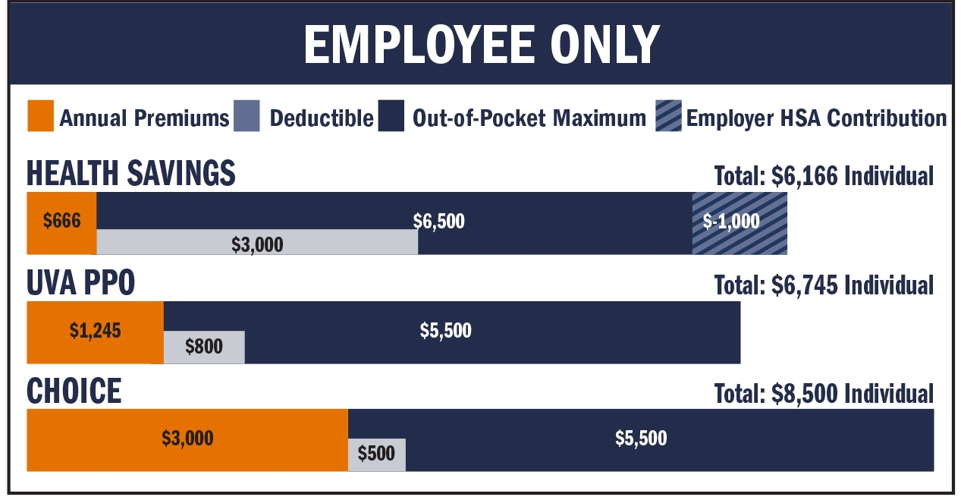
Notes:
The orange is the annual premium. As a reminder the premium is “the amount that must be paid for your health insurance or plan.” The lighter blue is the deductible. The deductible is “An amount you could owe during a coverage period (usually one year) for covered health care services before your plan begins to pay”. There is also the striped area noted in the Basic Health plan. This denotes the employer contribution to the health savings account.

Slide 30
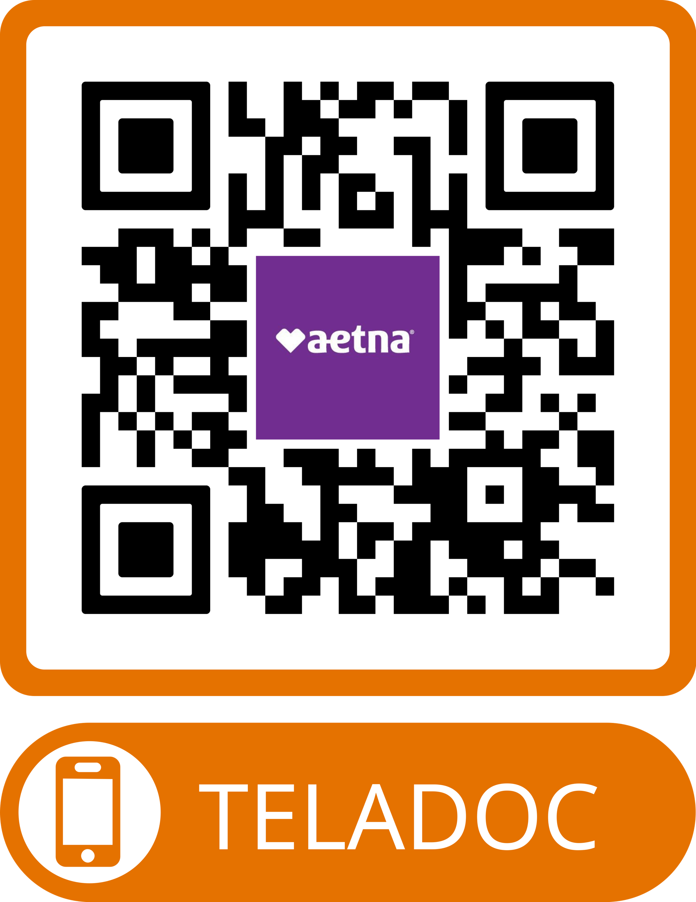
Increasing Access to Care: Teladoc Health Care
Introducing a new service: Teladoc Virtual PCP/Primary Care 360
Teladoc’s Virtual Primary Care connects you to a dedicated care team:
Dedicated primary care physician (PCP) of your choice who coordinates all aspects of your health (18 years+)
Access to nurses, health coaches, and specialists to help manage your health
Ongoing health management including annual checkups, preventative services, chronic condition care, urgent care for non-emergencies, personalized health plans, and referrals
Access to 24/7 Care (18 months+), mental health (13 years+), dermatology, and more*
Cost savings
UVA PPO and Choice members pay $0 for all virtual primary care visits
Health Savings members: $145 initial visit; $85 until deductible met, then $0
Reduce ER visits and hospitalizations through proactive care
Annual wellness visits are paid in full for all three health plan options
Call 855.835.2362
* Additional services are subject to change based on your benefit offerings.
Notes:
There are so many reasons that Primary360 may be the perfect fit for your healthcare needs.
Similar to a traditional primary care provider, Teladoc Health offers the same comprehensive care and more, including regular check-ups, screenings, access to a dedicated Care Team and 24/7 care when you have non-emergency health issues
Annual checkups are $0 and because they provide proactive care, you can reduce ER visits and hospitalizations – saving you time and money.
You can easily schedule appointments that fit your availability and have those appointments by phone or video. And if you need to be referred to an in-person specialists, they help coordinate that with a low cost/high quality specialist.

Slide 31


Dental Plan
Basic and Enhanced Options Include
100% coverage for in-network preventive care​
Modest Deductible: $50.00/year; applies to non-preventive services
Enhanced Covers Orthodontia Care
Orthodontia Care: You pay 50%; Plan pays 50%​
Lifetime Maximum Orthodontia Benefit: $1,500 per person
(increased benefit; was $1,000 lifetime max)
Annual Maximum Benefit
Basic: $1,000​
Enhanced: $2,000
Major Restorative Work
Basic: You pay 50% after annual deductible; Plan pays 50%​
Enhanced: You pay 40% after annual deductible; Plan pays 60%
Notes:
2026
Enhanced Covers Orthodontia Care
Orthodontia Care: You pay 50%; Plan pays 50%
Lifetime Maximum

Slide 32
2026 Monthly Dental Premiums
UVA Dental Plan | Basic | Enhanced
Employee | $2.75 (+$1.75) | $13.75 (+$3.25)
EE+Child(ren) | $5.25 (+$3.25) | $31.75 (+7.00)
EE+Spouse | $7.50 (+$3.50) | $36.00 (+$7.00)
Family | $12.50 (+$5.25) | $61.75 (+$12.00)
New rates are listed above along with the $ change from 2025
If you are paid bi-weekly, divide the monthly premiums by 2
There are no changes to coinsurance or deductible
The orthodontia allowance in the Enhanced Plan increased from $1,000 to $1,500.
Rates for COBRA, Postdoctoral fellows, J Visa, and Housestaff differ from above; you can see your rates online at hr.virginia.edu/OE2026

Slide 33



Vision Plan
UVA offers two options to save on eyecare:
Davis Vision Coverage
Annual eye exam
Lenses & frame allowance, or contacts​
Frames and contact lens allowance will increase from $130 to $150
Discounts on additional products, scratch resistance, transitions, etc.
Aetna Vision Discount Program
UVA Health Plan participants are automatically enrolled in the Aetna Vision Discount Program, without additional premium.
Vision plan options cannot be combined in one visit.​​

Slide 34
2026 Monthly Vision Premiums
Davis Vision | Rate
Employee | $7.90 (-$0.42)
EE+Child(ren) | $13.83 (-$0.73)
EE+Spouse | $14.23 (-$0.75)
Family | $22.14 (-$1.16)
The 2026 rates are slightly less than the 2025 rates
If you are paid bi-weekly, divide the monthly premiums by 2
Rates for COBRA, Postdoctoral fellows, J Visa, and Housestaff differ from above; you can see your rates online at hr.virginia.edu/OE2026

Slide 35


Health Care Flexible Spending Account (FSA)
Who is eligible
Any benefits-eligible employee not enrolled in the Health Savings option for health care coverage
Employees on Health Savings option may elect limited FSA for dental/vision only​
Do not have to be on the UVA Health Plan to elect an FSA
You and your spouse cannot have a Full FSA & HSA in the same year​
Benefits
Contribute pre-tax through payroll deduction​
Use for eligible medical, dental, Rx, and vision expenses for that calendar year, plus a grace period through March 15 of the next year ​
Elect up to $2,500 in FSA per year​; minimum contribution $120/year
Full FSA balance available up front​
Use or lose – use all funds by the grace period or forfeit them

Slide 36

Life Insurance
All benefited employees have basic life insurance provided by UVA​
You can request additional, optional life insurance at any time during the year ​
Evidence of insurability is required; reviewed and determined by the vendor
Exception for ORP, MCRP participants only:
During Open Enrollment:
If you are currently enrolled and have 1x or 2x optional life coverage, you may increase by one level without providing medical evidence of insurability. However, coverage cannot exceed 3x your salary or the maximum of $500,000.
If your spouse is currently enrolled with $25,000 coverage, you may increase spouse coverage to $50,000 without medical evidence of insurability.
Notes:
You can request changes to your supplemental life insurance at any time during the year. However, except for new hires who are within their first 30 days, requests for additional life insurance will be subject to medical underwriting. This means that you will be asked to provide health information and the vendor will review your request before deciding if it will be approved.
ORP and MCRP participants - you can increase supplemental life insurance (one additional level) without medical "evidence of insurability" only during Open Enrollment, if you are already enrolled.
Guaranteed Issue amount is lesser of 3x your salary or $500,000
VRS participants – you have a similar option to increase supplemental life insurance, but outside of Workday; see the Life Insurance webpage for details.

Slide 37

Action Items
Re-elect Healthcare FSA and/or Dependent Care FSA if you wish to continue for 2026.
Remember, if you add dependents or add new coverage for existing dependents, you must upload required documentation before you submit your elections. If you change health, dental and/or vision plans, make sure to carry over any dependents to the new plan.
Print/save your benefits elections confirmation statement AFTER submitting. Review it carefully before Open Enrollment closes to ensure it reflects your desired enrollments.
NEW Health Savings participants: ​
Watch for communications from Fidelity in case action is needed to open your HSA. ​
If your HSA account is not opened within 90 days, you will forfeit the employer contribution, and your personal contributions will be returned.
Remember, if you currently have a Full Healthcare FSA and you plan to open an HSA in 2026, spend funds down to $0.00 by 12/31/2025.
Monitor your balance throughout December for unexpected provider refunds.

Slide 38

Advice, Tools, & Resources
PRESENTED BY
Rich Carroll – Financial Consultant

Slide 39
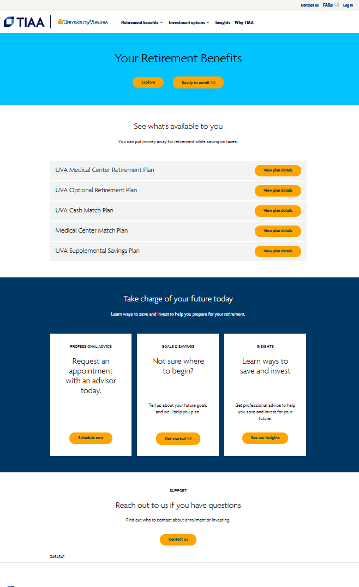
UVA Retirement Plans
Visit TIAA.org/uva to:
Enroll in the UVA plans
Log in to your TIAA account
Research investment options
Request an appointment with a financial consultant
Establish your goals & savings
And more…
Notes:
The TIAA site for the UVA retirement plans can be found at TIAA.org/uva. You can visit this site at any time to enroll in the UVA retirement plans, log in to your TIAA account, register for online access, research investment options, request an appointment with me your local financial consultant or a virtual appointment. You can also answer 5 quick questions to establish your goals and savings online.

Slide 40

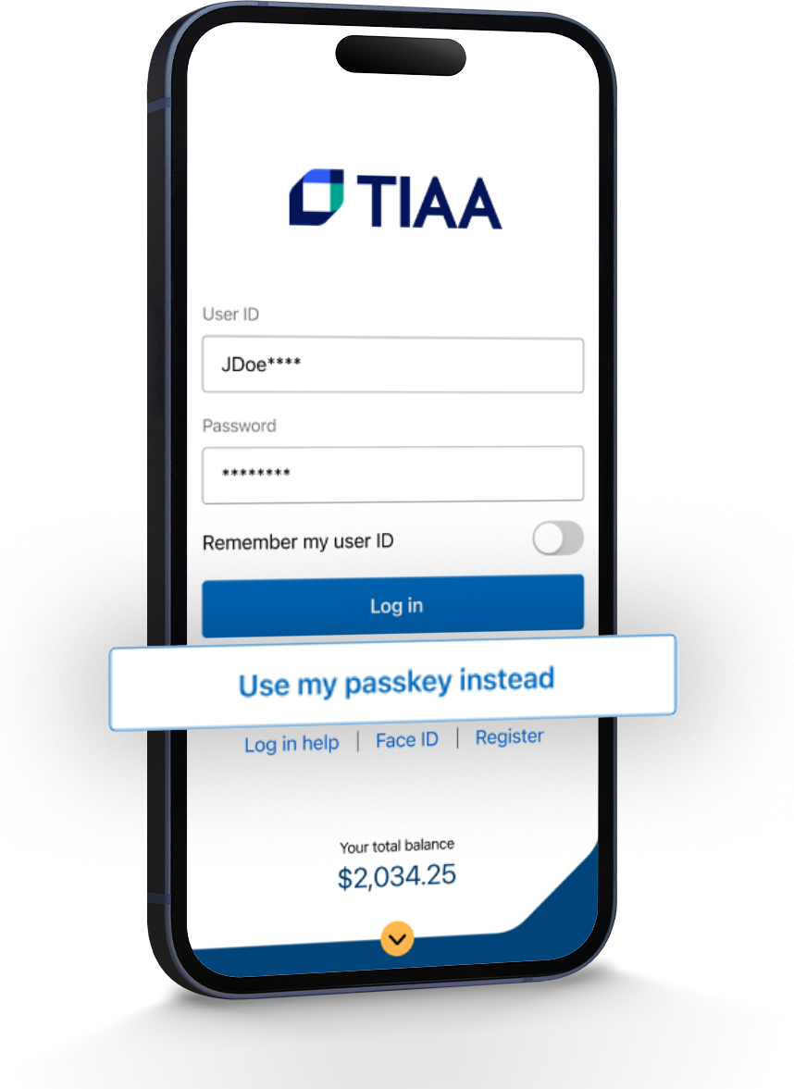

SAY GOODBYE TO PASSWORDS WITH PASSKEY.
Notes:
TIAA has enhanced how you can log in to your account by introducing PASSKEY. This is a way to skip the passwords and create a passkey to log in to your account with your face, fingerprint, or PIN. PASSKEYS offer easier, safer single-step multi=factory authentication, but you can still use passwords to log in. The PASSKEY allows you to use biometrics and we do not collect or store any biometric data, allowing a PASSKEY to be more secure.

Slide 41
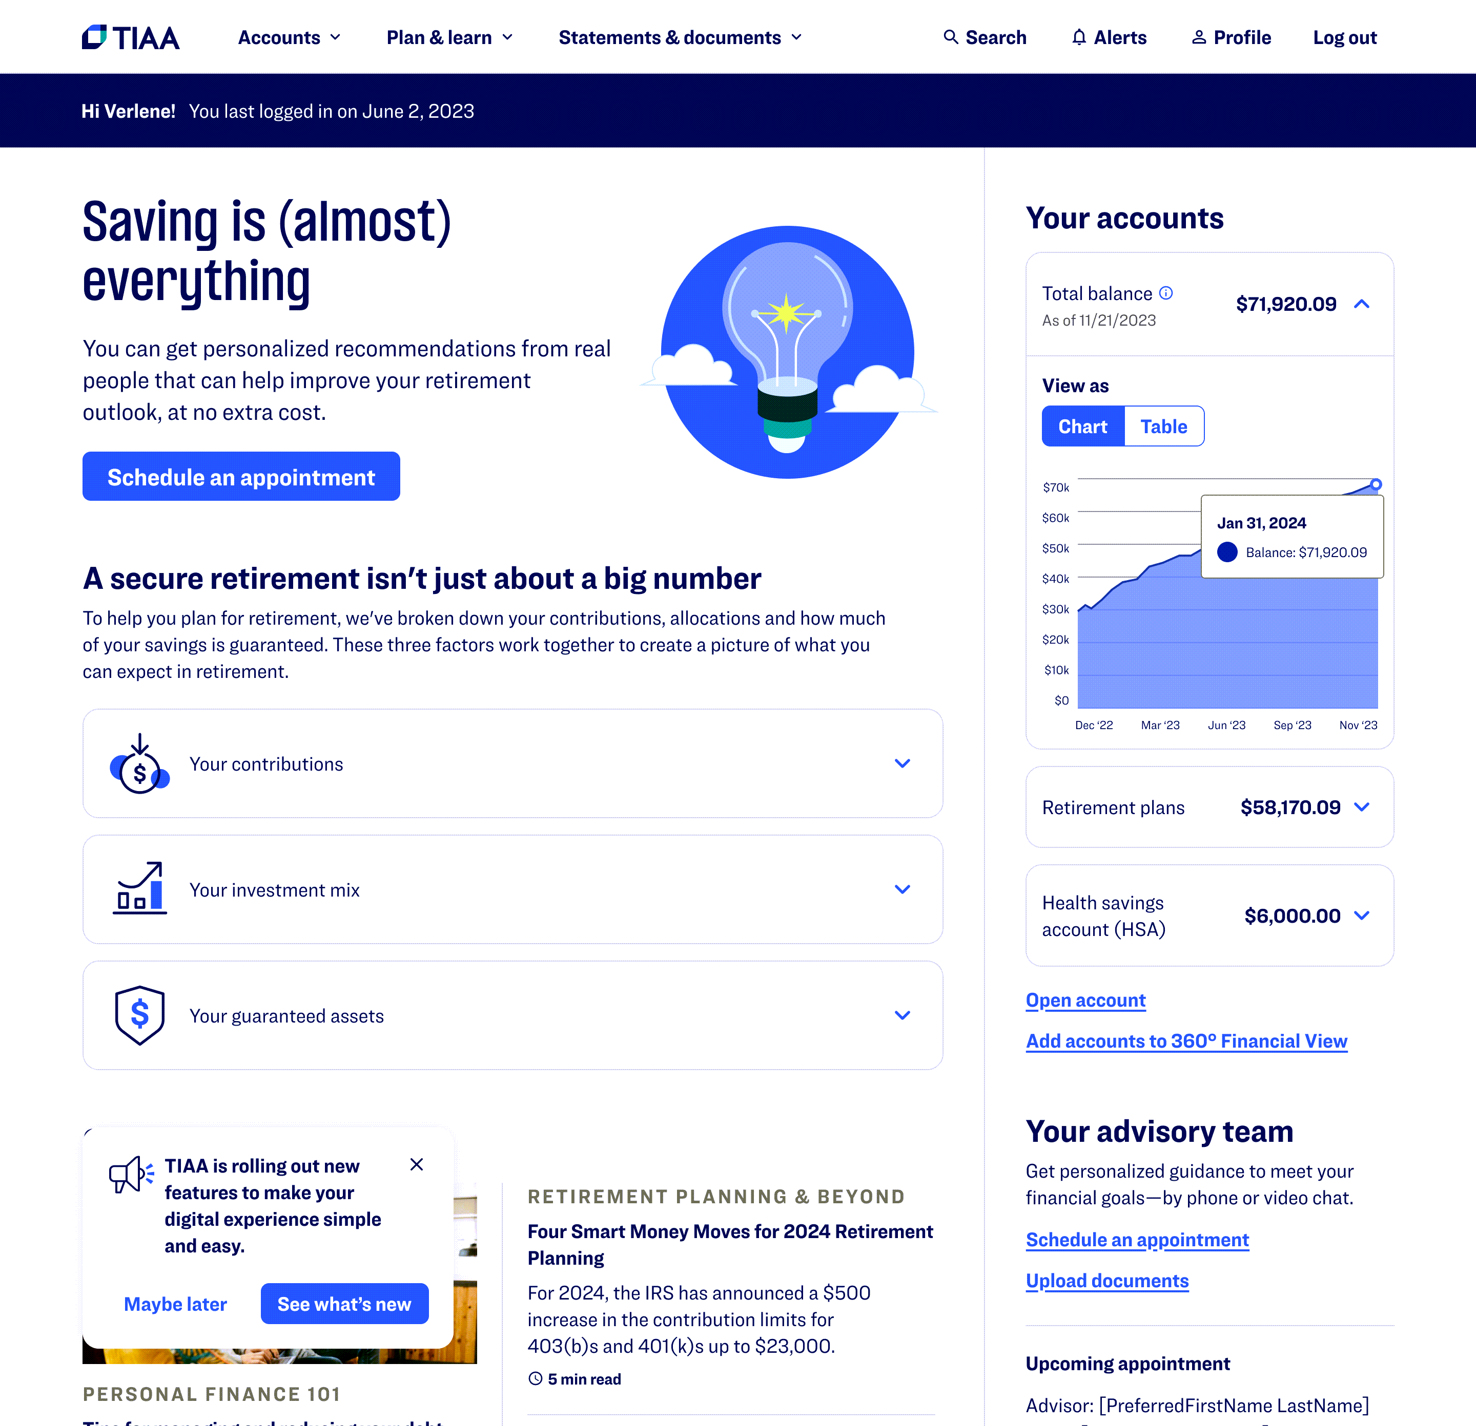
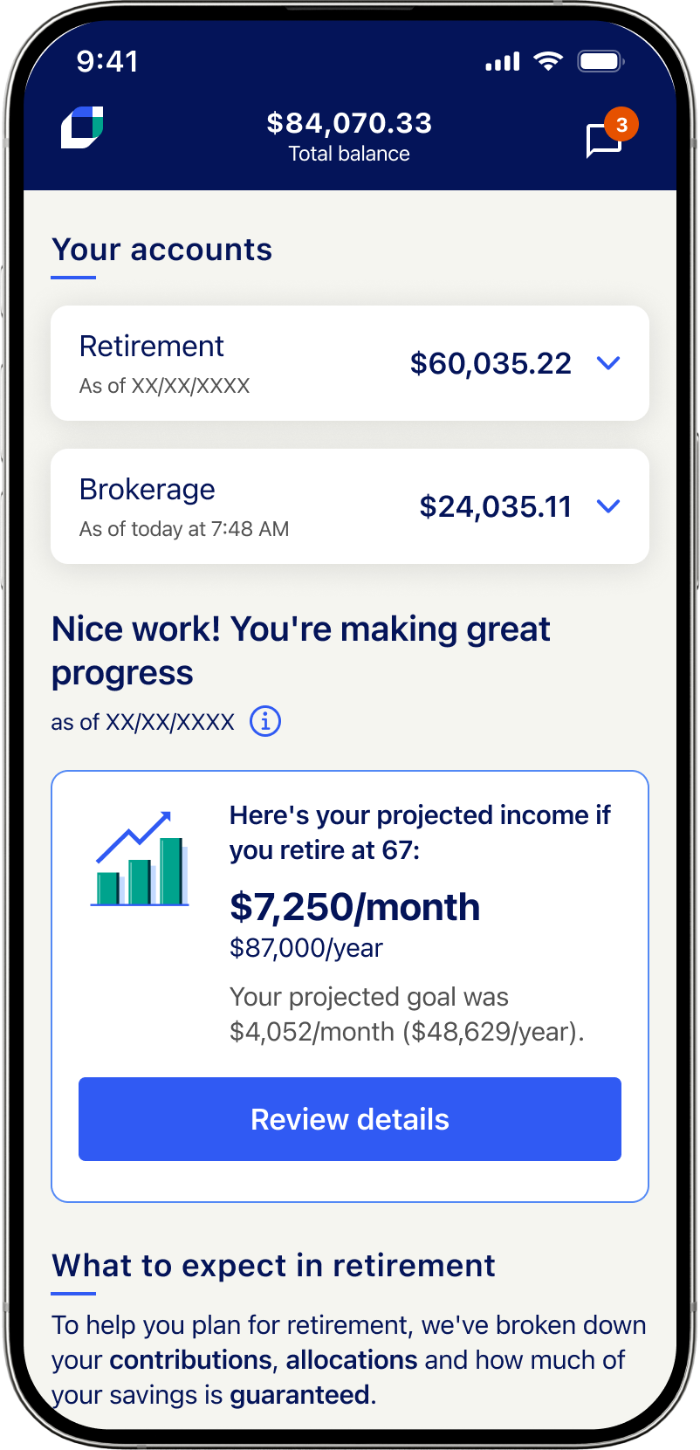
TIAA Homepage
Notes:
The TIAA homepage has dynamic components that provide personalization. The experience is visually clean, and instead of just showing your balance, we provide insight into your retirement journey by including “How much spending power will I have in retirement?”.
In the Save section, you can see a clear breakdown of your contributions and have easy access to a planning calculator.
In the Manage section, you can see a breakdown of your investments, along with education on each asset type to help you increase your financial proficiency.
In the Protect section, we educate them on the importance of lifetime income. If you have money invested in TIAA Traditional, we display your estimated monthly income, as well as your TIAA Loyalty Bonus amount.
On the bottom right, you can use the 360 Financial View tool which allows you to add in and track all of your financial accounts (bank, mortgage, debit card, credit card, etc.) and use the tools to help you track your spending. You may find out you are ordering Door Dash too much impacting your savings plans.
You can also select “Schedule an appointment” and set up an advice session with me or with our virtual financial consultants.
So not only do we show you your balances on the homepage, we also have action items and bite sized articles and videos to link to for additional financial wellness opportunities.
And, finally, our new homepage experience carries over to the TIAA mobile app, to ensure you receive retirement guidance in any channel you engage with us on.

Slide 42
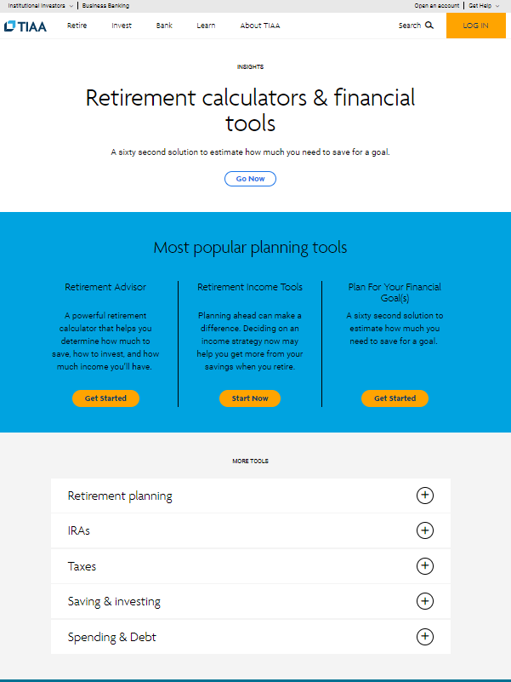
TIAA.org/tools
Retirement calculators & financial tools
A sixty second solution to estimate how much you need to save for a goal
Retirement Journey Planner
Lifetime Income Calculator
Budget & Retirement Budget Worksheets
Debt Illustrator
And more…
Notes:
I would like to highlight a few retirement calculators and financial tools at your fingertips! You can start at TIAA.org/tools and you can select from a large number of our online tools. You will find Retirement Journey Planner which is a powerful calculator that helps you determine how much to save, how to invest, and how much income you’ll have. Or you may find the Goals tab and get started on setting goals and creating a budget to reach your goals.
If you need help managing debt, use our Debt Illustrator which helps you chart your credit card debt, student and personal loans, identify how much interest to pay and help you create a target date to become debt-free.

Slide 43
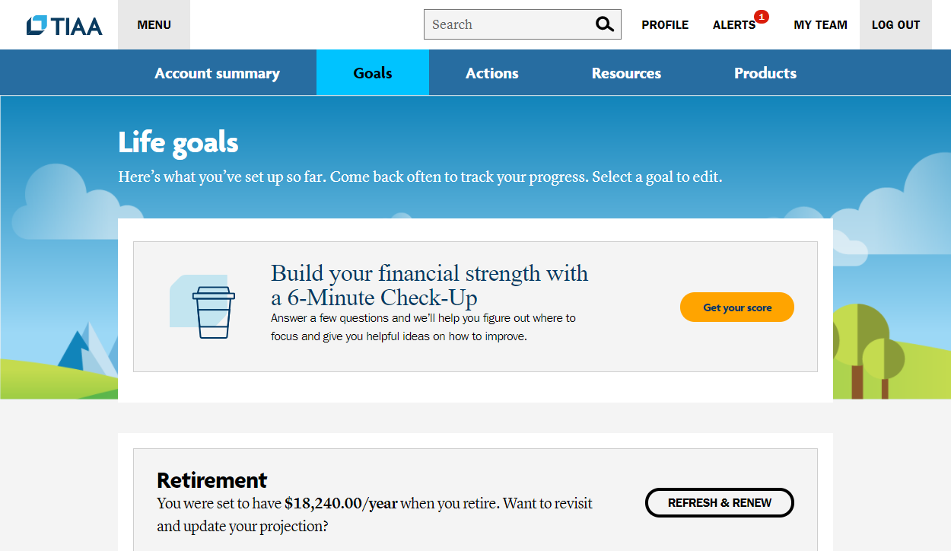
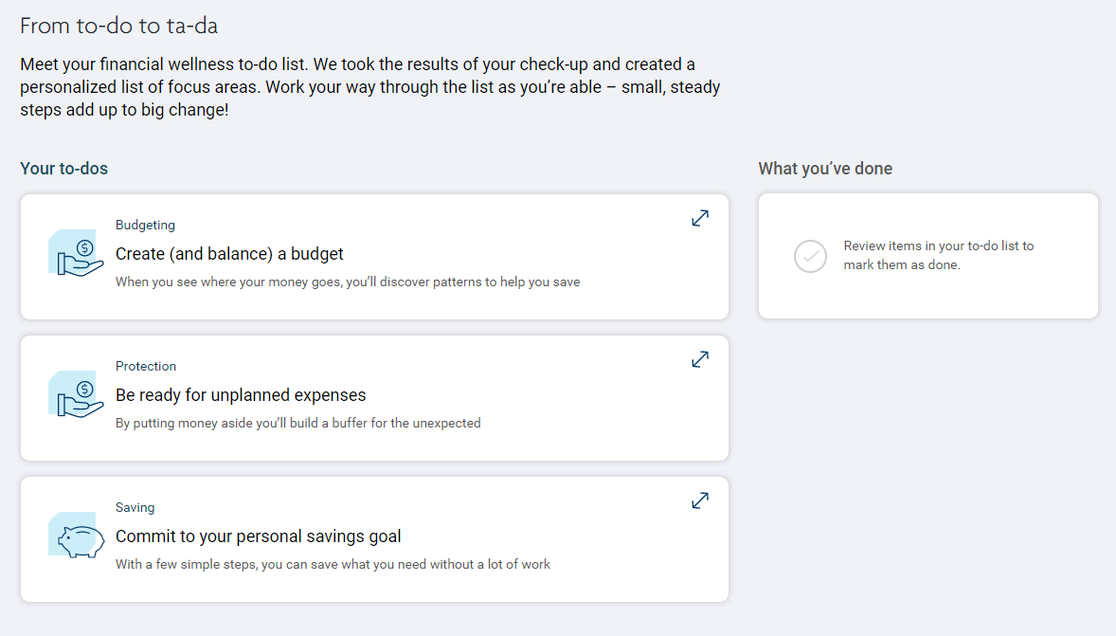
6 Minute Check up
Self-assessment tool to help individuals understand their current financial situation and create a personal plan
Answer a few simple questions about your current situation
Receive a personalized list of topics
Track progress and tackle the next topic when you’re ready
Notes:
We have a new tool if you want a quick action plan which is our 6-Minute Check-Up which is available to participants when the log into their account under the Goals tab. We know that many out-of-plan issues – like debt burdens– can affect a participant's ability to save enough for retirement, or even enroll in the first place. The 6 Minute checkup is a simple, diagnostic, digital-first solution that creates a personalized action plan to guide participants to save more for retirement, rebalance their portfolio as necessary and address lifetime goals through education.
Optional based on time: The first step in achieving financial wellness is for individuals to develop an understanding of their current situation, establish goals and follow a plan. The 6-Minute Check-Up support a participants' ability to budget and improve their financial acumen, increasing their overall financial health and, ultimately, the available cash flow to contribute to a retirement program.

Slide 44
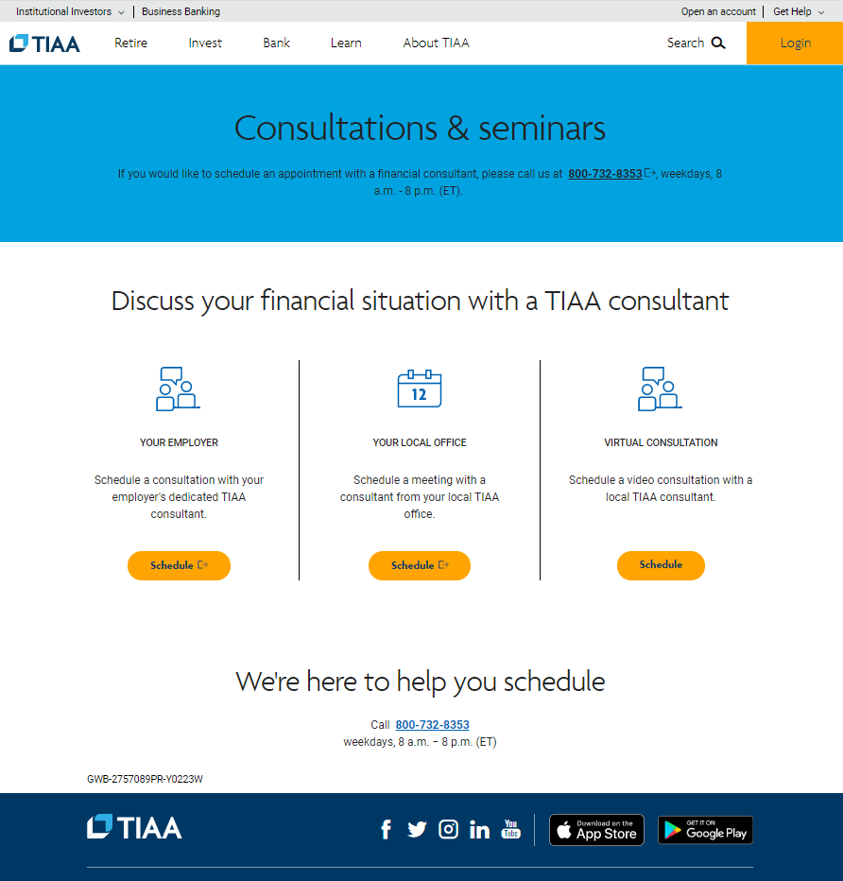
TIAA Financial Consultants
Schedule an appointment
Please visit TIAA.org/schedulenow or call toll-free 800-732-8353, weekdays, 8 a.m. to 8 p.m. (ET)
Visit TIAA.org/webinarschedule to register for live webinars or watch past presentations on demand.
Notes:
Read slide and talk about financial well-being:
This is meant to be a quick overview of the TIAA advice and online tools. To check out our online tools, you can visit TIAA.org/tools . We want you to have Financial well-being now and in retirement. Yes, we’re always thinking about retirement, but you should be as well. Of course, that doesn’t mean you can’t enjoy getting there.
If you want to hear more about TIAA’s online tools, our next online tools webinar “At your fingertips: Manage your money from where you are” is scheduled for June 15, 2022 at www.TIAA.org/webinars2022

Slide 45
Advice is obtained using an advice methodology from an independent third-party.
This material is for informational or educational purposes only and is not fiduciary investment advice, or a securities, investment strategy, or insurance product recommendation. This material does not consider an individual’s own objectives or circumstances which should be the basis of any investment decision.
Certain products and services are only available to eligible individuals.
Images portrayed throughout this deck are snapshots for illustrative purposes only.
TIAA-CREF Individual & Institutional Services, LLC, Member FINRA, distributes securities products. Annuity contracts and certificates are issued by Teachers Insurance and Annuity Association of America (TIAA) and College Retirement Equities Fund (CREF), New York, NY. Each is solely responsible for its own financial condition and contractual obligations.
Investment products may be subject to market and other risk factors. See the applicable product literature or visit TIAA.org for details.
Investment, insurance and annuity products are not FDIC insured, are not bank guaranteed, are not deposits, are not insured by any federal government agency, are not a condition to any banking service or activity, and may lose value.
TIAA.org
©2025 Teachers Insurance and Annuity Association of America-College Retirement Equities Fund, 730 Third Avenue, New York, NY 10017
4763776 08/25

Slide 46
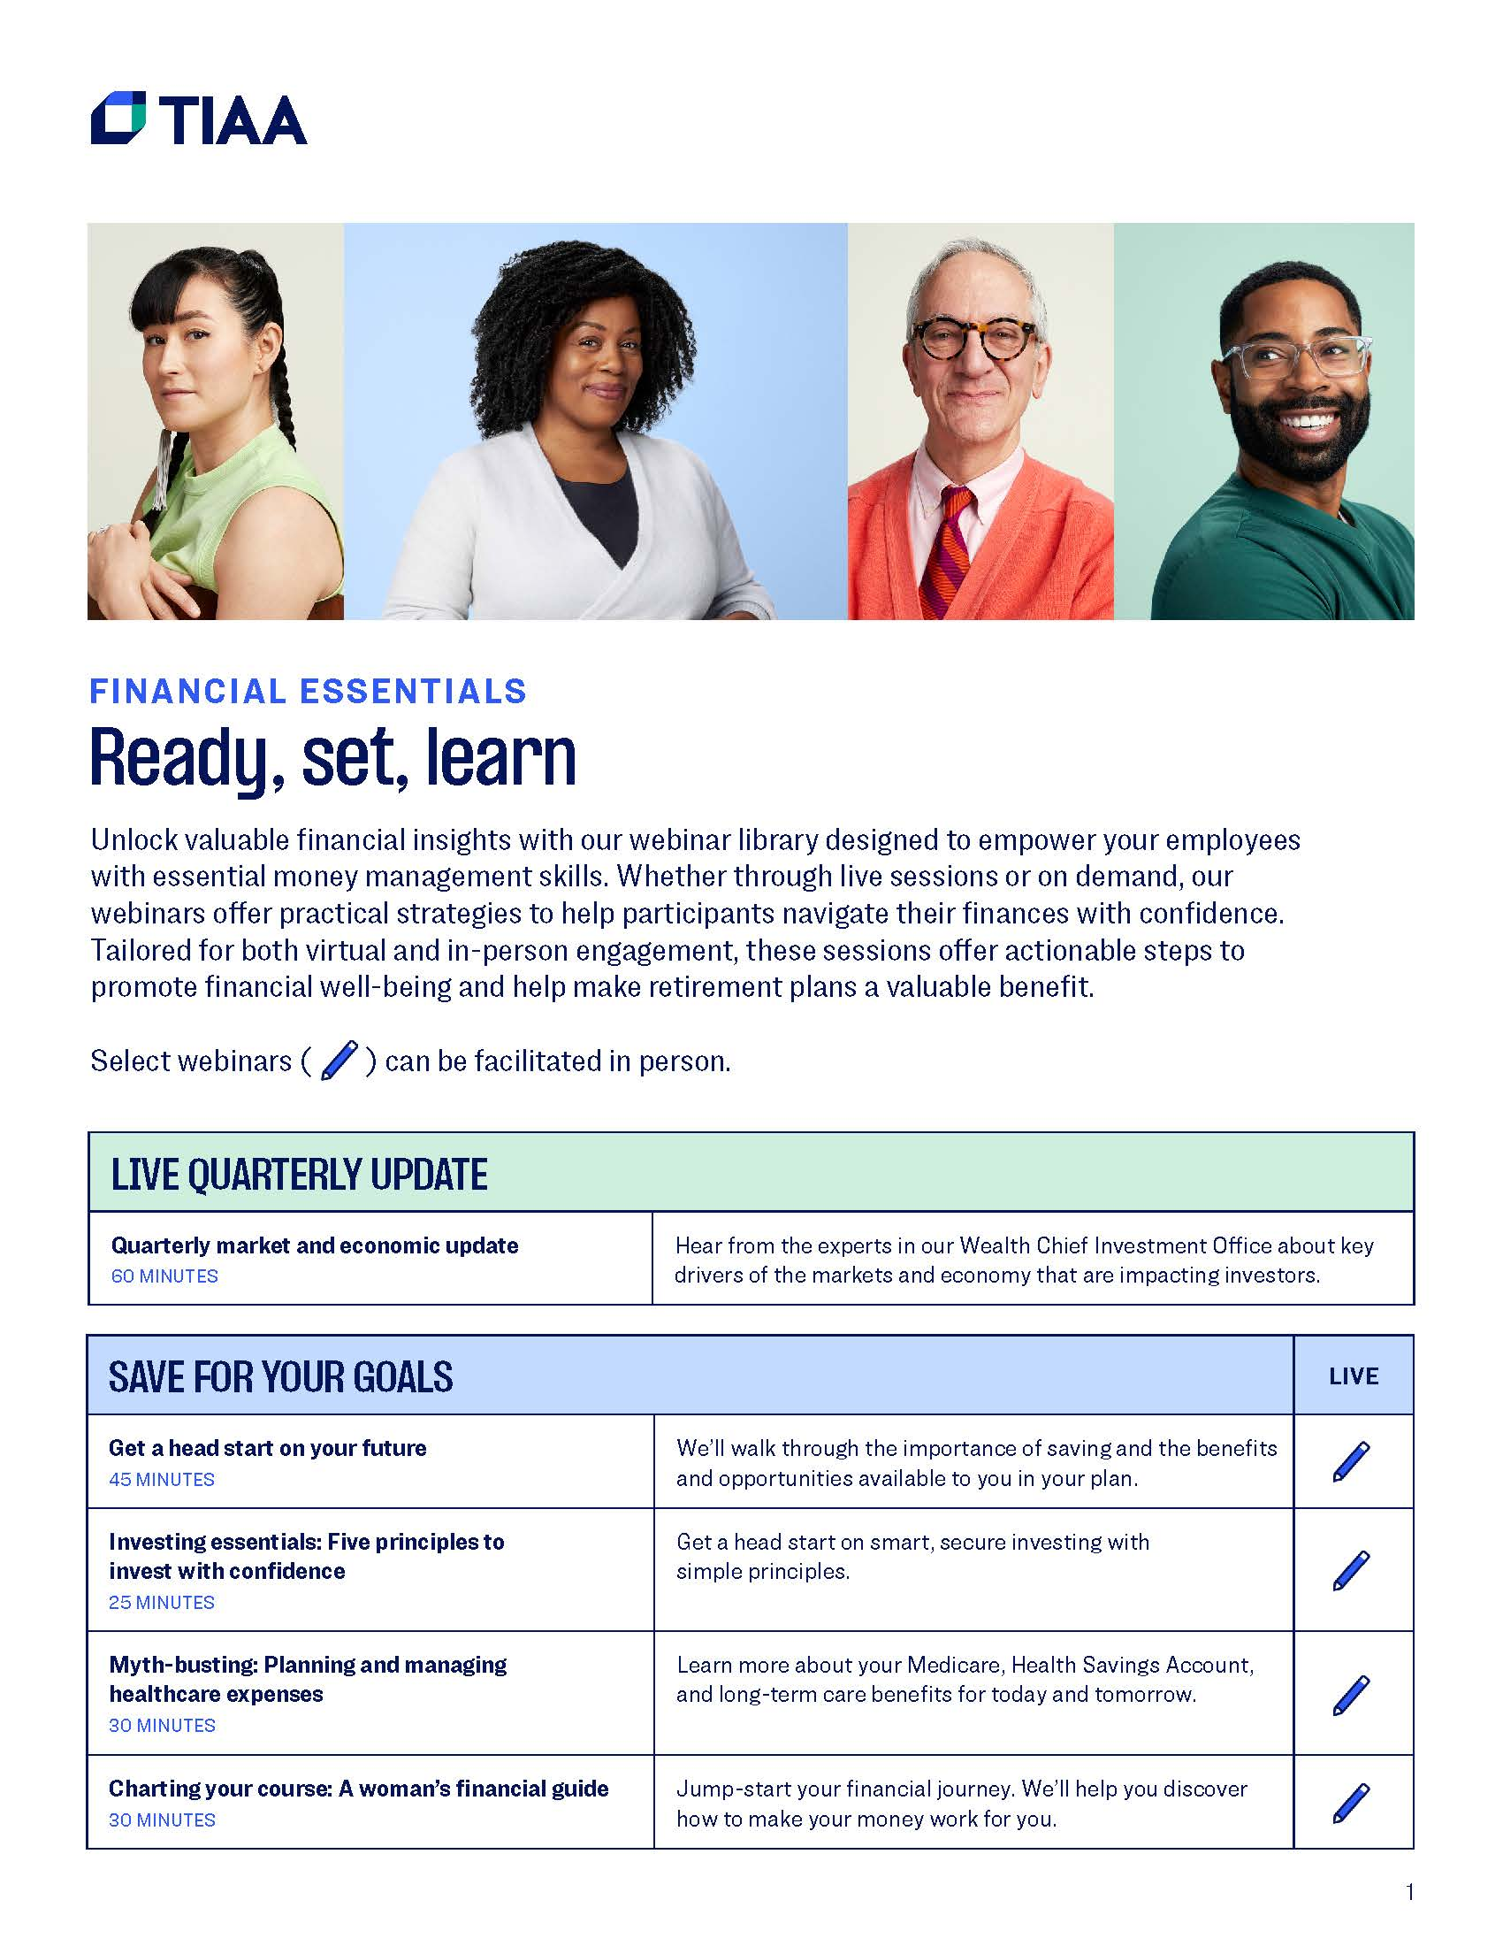

Slide 47
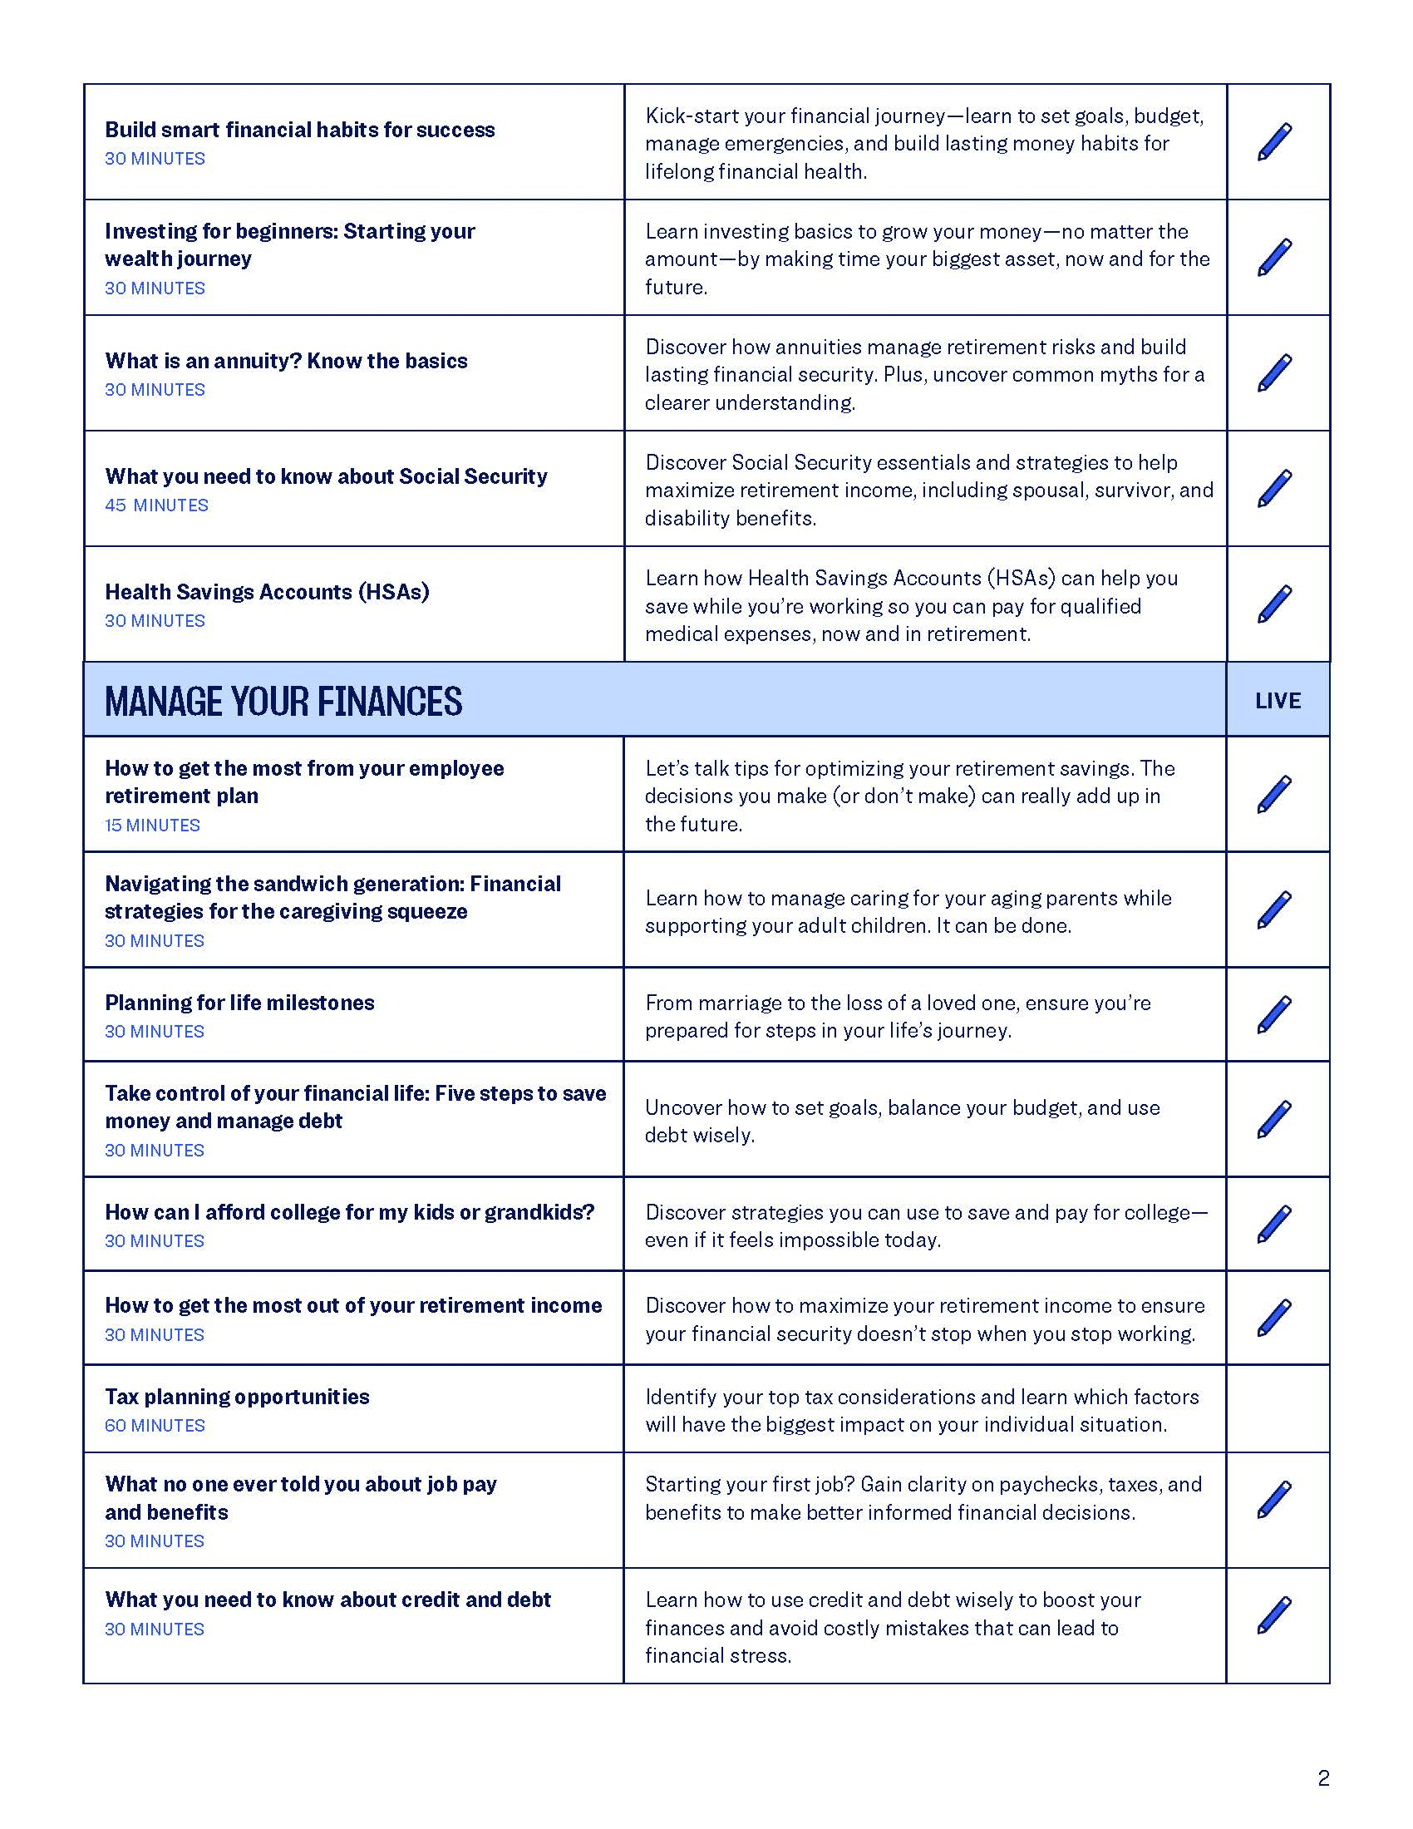

Slide 48
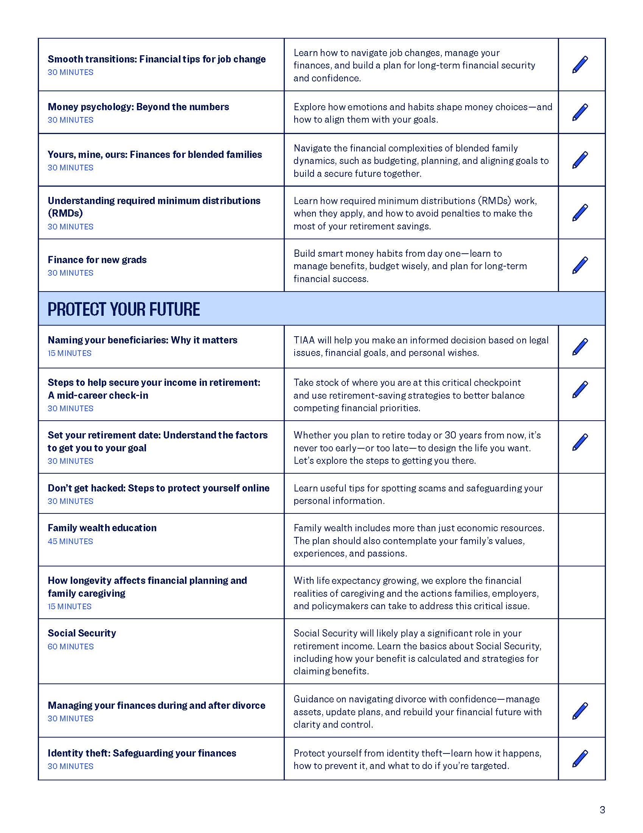

Slide 49
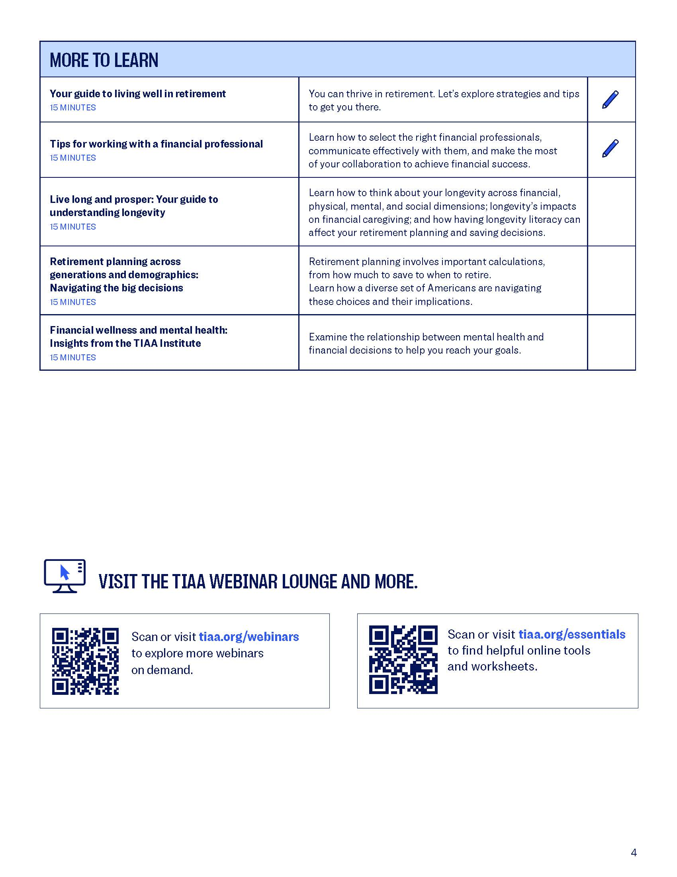

Slide 50
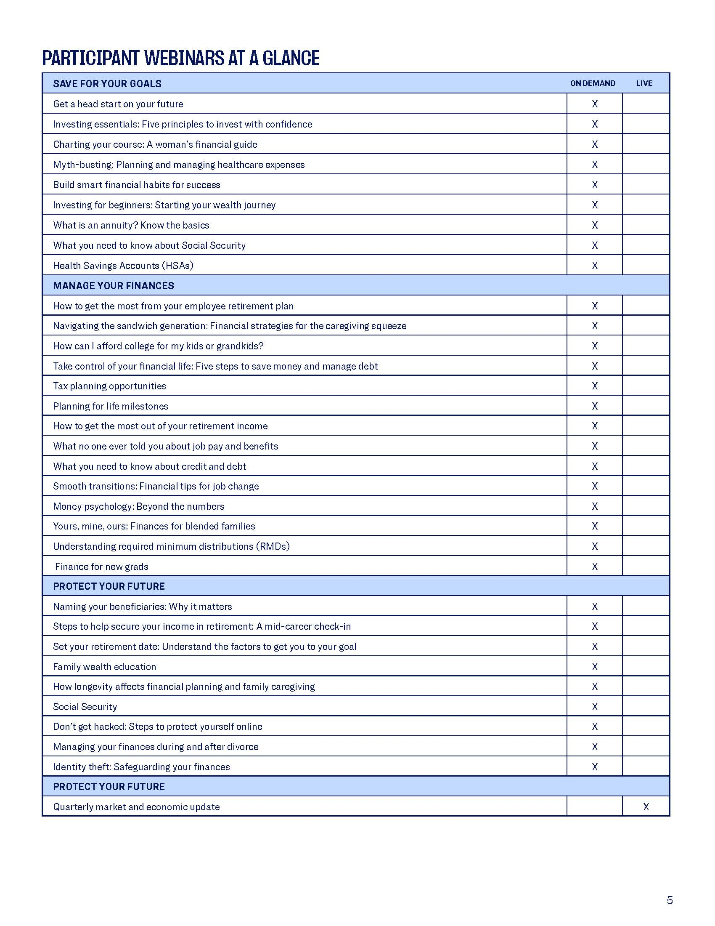

Slide 51
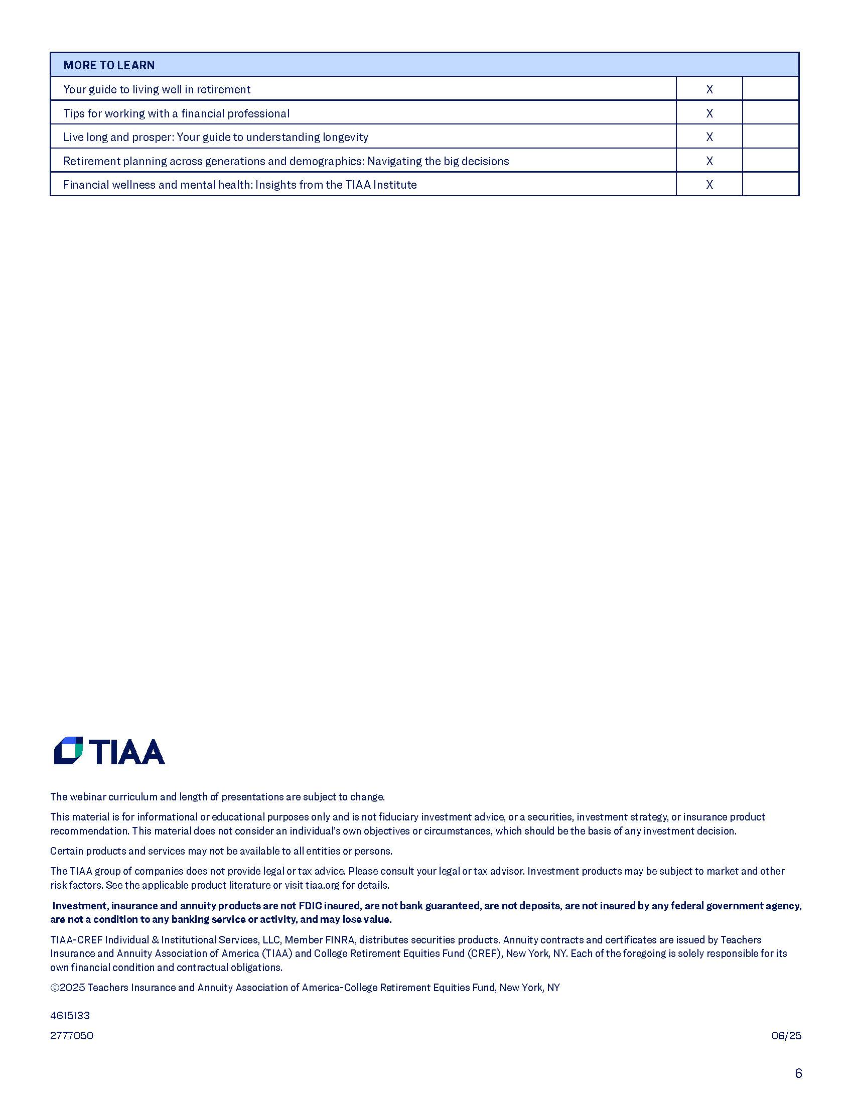

Slide 52


THANK YOU!

