Slide 2
Thank you!
For completing the survey
For participating in the Work Unit Results Review Session
For helping us understand our results
You are a valued member of our team!

Slide 3
Objectives
Review and discuss work unit results
Identify key actions
Communicate our follow-up plan

Slide 4
Ground Rules
We request that you…
Help us understand the meaning behind the results
Provide honest and candid feedback
Offer constructive suggestions for improvement
Identify the highest priority items
Help us focus on those areas we can control within the department and team
Notes:
The Ground Rules listed are a foundation for ensuring an effective and efficient Results Rollout Session. You are invited to add additional ground rules if you see a need based on your work unit.

Slide 5
Work Unit Feedback Process
Review Engagement, Leader Index, and Team Index Scores
Review Strengths and Concerns
Review Key Drivers
Clarify Results with Team
Define Potential Actions
Prioritize Next Steps

Slide 6
Engagement score
 | Work Unit Average | Organizational Average
Engagement Indicator | Enter # Here | 3.96
Domain | Work Unit Average | Organizational Average
Organizational Domain | Enter # Here | 3.85
Manager Domain | Enter # Here | 4.15
Employee Domain | Enter # Here | 4.07
DESCRIPTION
The Engagement Score indicates the degree of commitment team members feel toward the organization. Work units that are very connected to the organization will have a very strong level of commitment.

Slide 7
Leader Index (LI) score
Enter Work Unit Here
Enter LI Score Here
DESCRIPTION
The LI Score represents team members’ readiness to engage in feedback and action planning. The score is assigned through calculations on a 100-point scale from survey items specific to manager performance.
 | INDEX
READINESS |  | SCORE
High readiness |  | 90-100
Moderately high readiness |  | 80-89
Moderate readiness |  | 70-79
Moderately low readiness |  | 60-69
Low readiness |  | 0-59
Notes:
Please remind the group that we share and review the results first, then come back to action plan.

Slide 8
Leader index (LI) score
Action Planning Readiness Items | Domain
The person I report to treats me with respect. | MGR
The person I report to encourages teamwork. | MGR
I am involved in decisions that affect my work. | MGR
I respect the abilities of the person to whom I report. | MGR
The person I report to is a good communicator. | MGR
The person I report to cares about my job satisfaction. | MGR
Notes:
Manager-employee relationship
Based on 6 Manager Domain Items
Used consistently across all PG clients
Reported on a 100 point scale; higher scores indicate a stronger manager-employee relationship
Who “owns” the APR score?
Answer: The manager
Reason: Fosters individual accountability for leader improvement.

Slide 9
Team Index (TI) score
Enter Work Unit Here
Enter TI Here (I, II, or III) | Enter Power Item Score Here
DESCRIPTION
The TI Score is a team outcome metric based on items that most powerfully impact team performance
 | INDEX
TIER | PERFORMANCE | POWER ITEM SCORE
Tier I | Above Average Performance | 5.0 - 4.15
Tier II | Average Performance | 4.14 - 3.80
Tier III | Below Average Performance | 3.79 or below

Slide 10
Team Index score
Power Item | Domain
Different work units work well together in this organization. | ORG
This organization conducts business in an ethical manner. | ORG
This organization provides high-quality care and service. | ORG
This organization supports me in balancing my work life and personal life. | ORG
My pay is fair compared to other healthcare employers in this area. | ORG
This organization treats employees with respect. | ORG
This organization provides career development opportunities. | ORG
The person I report to treats me with respect. | MGR
I am satisfied with the recognition I receive for doing a good job. | MGR
I am involved in decisions that affect my work. | MGR
I respect the abilities of the person to whom I report. | MGR
The person I report to is a good communicator. | MGR
My work unit works well together. | EMP
I like the work I do. | EMP
My job makes good use of my skills and abilities. | EMP
Notes:
Based on the 15 Power Items; the items that most powerfully impact team performance
Cross section of ORG, MGR and EMP items
Who “owns” the Tier Score?
Answer: The team
Reason: Fosters work unit accountability for self-regulation; managers facilitate team improvement and report on team progress.

Slide 11
strengths
Item | Domain
Enter Item Here | Enter Domain Here
Enter Item Here | Enter Domain Here
Enter Item Here | Enter Domain Here
Enter Item Here | Enter Domain Here
Enter Item Here | Enter Domain Here
Enter Item Here | Enter Domain Here
Enter Item Here | Enter Domain Here
Enter Item Here | Enter Domain Here
Enter Item Here | Enter Domain Here
Enter Item Here | Enter Domain Here

Slide 12
concerns
Item | Domain
Enter Item Here | Enter Domain Here
Enter Item Here | Enter Domain Here
Enter Item Here | Enter Domain Here
Enter Item Here | Enter Domain Here
Enter Item Here | Enter Domain Here
Enter Item Here | Enter Domain Here
Enter Item Here | Enter Domain Here
Enter Item Here | Enter Domain Here
Enter Item Here | Enter Domain Here
Enter Item Here | Enter Domain Here

Slide 13
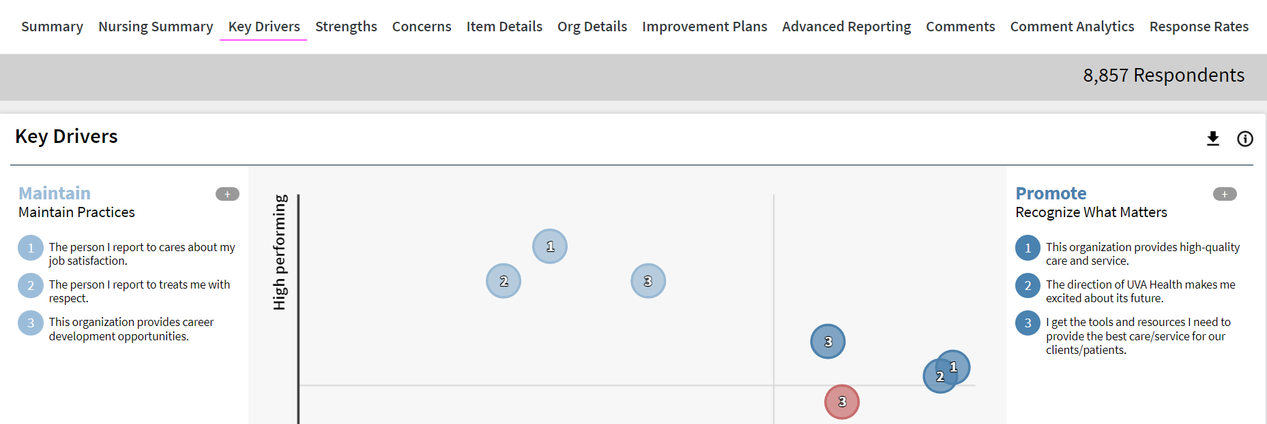
Key Drivers
Download Key Drivers graphic and paste here

Slide 14
Summary
Enter any summary observations or information here

Slide 15
Clarification of results: strengths
What are our strengths that we want to build upon as a team?
Did any of our strengths surprise you?

Slide 16
Clarification of results: concerns
What help can you provide in understanding the identified areas of concern?
Did any of these areas of concern surprise you?

Slide 17
Next steps
Summarize feedback
Hold action planning session
Share action plan with team
Regularly review action plan

