Slide 1
Audience:
Course Owner(s):
Date Published:
For questions related to the course content, contact: (Full Name, email address and/or full phone number)
© 2025 by the UVA Health System

Slide 2
Training Requirements
Include any other lessons that are a part of this course, instructions to complete the course, navigation instructions, etc.
A grade of ###% on the post test is required to successfully complete the course.
Directions can be included on other slides and do not need to stand alone.

Slide 3
Learning Objectives
Consider what the learner should be able to DO after the training. Consider what it would be if you took a picture of them doing it.
Upon completion of this module, the <audience> will be able to:
Objective 1
Objective 2
Objective 3
Notes:
Script

Slide 4
Learning Objectives
Consider what the learner should be able to DO after the training. Consider what it would be if you took a picture of them doing it.
Upon completion of this module, the <audience> will be able to:
Objective 1
Objective 2
Objective 3

Slide 5
Introduction (optional)
Include introduction if needed. Delete slide if introduction will not be included.

Slide 6
Section Title
Summary or introduction, as needed.

Slide 7
Section Title
Summary or introduction, as needed.

Slide 8
Content

Slide 9
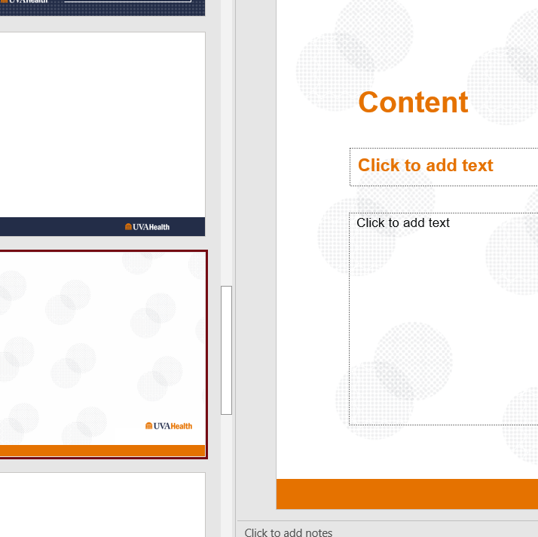
Content
This is what I want you to see

Slide 10
Content

Slide 11
Interaction – Multiple Choice, Multi-Response, True/False
Note to developer:
To request up to two quiz questions, you must fill out the table below in the correct format (instructions here).
If you have more than two questions, use the StorylineTestTemplate.xls and submit that file with the PowerPoint, indicating which page should have which questions.
Also indicate in the slide notes whether you want the learner to try again until correct, try again a limited number of times, or move on for a final score even if incorrect.
Identify a passing score for the quiz.
//Question Type | //Points | //Question Text | //Answer Choice 1 | //Answer Choice 2 | //Answer Choice 3
MC | 5 | Who was the first president of the United States? | *George Washington | That’s correct! | Thomas Jefferson | Not quite… | Abraham Lincoln | Not quite…
Notes:
Indicate correct answer with asterisk
Identify if you want the learner to try again (if so, how many times, or until correct), or move on for final score
Identify what a passing score for the quiz should be for the learner.

Slide 12
Review of Learning Objectives
Think about what the learner should have learned to be able to DO after the training. Consider what it would be if you took a picture of them doing it.

Slide 13
Exit
If there are multiple lessons in the course:
This lesson is complete. To continue to the next lesson, you may close this window to return to Workday Learning to continue to the next lesson / post test, etc.
If no additional lessons:
This course is complete. You may close the window to return to Workday Learning and this course will appear on your transcript.
For questions related to the course content, contact: (Full Name, email address and/or full phone number)
© 2025 by the UVA Health System

Slide 14
Exit
If there are multiple lessons in the course:
This lesson is complete. To continue to the next lesson, you may close this window to return to Workday Learning to continue to the next lesson / post test, etc.
If no additional lessons:
This course is complete. You may close the window to return to Workday Learning and this course will appear on your transcript.
For questions related to the course content, contact: (Full Name, email address and/or full phone number)
© 2025 by the UVA Health System

